Slide 1
Chemistry for Kids
Unit 2/A
The Study of Light and Chemistry

Slide 2
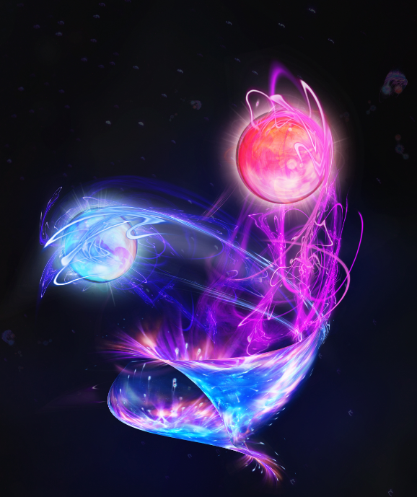
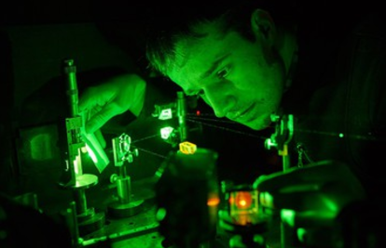
LIGHT - What does it have to do with Chemistry?
Nearly every Chemistry book starts with a chapter on understanding LIGHT.
But why?
Historically speaking, many discoveries about atoms come from observations on how atoms interact with light.
Observations from experiments prove that atoms interact with light waves.
Each type of atom restricts itself to interact with only specific colored light, and they disregard the rest.
Let's find out which part of the atom precisely is able to interact with light waves...

Slide 3

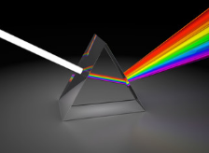
What do we know about Light so far?
Can you see the color of undisturbed sun light under normal circumstances?
No. We see through light most of the time, and it doesn’t seem to have any colors.
Most often we tend to forget it is even there.
Light is sometimes said to be WHITE, which simply means TRANSPARENT.
Even though it’s white, the light contains all the possible colors bundled together.
How can you see all those colors so they are visible
to the human eye?
In a rainbow
Through a prism
The term COLOR should be used loosely. We think of colors as something that humans and animals can see. Visible colors, also known as the “Visible Spectrum”. This spectrum is all about what human beings can see.
For example, INFRARED is not seen by humans, but it is seen by snakes, insects and some marine animals.

Slide 4
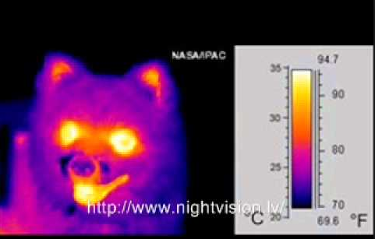
Colors can be classified in two categories:
the VISIBLE colors,
and the INVISIBLE ones.
What could invisible colors be like?
Infrared was already mentioned as such. It is not a color that humans can see. But Infrared is not entirely invisible to you. Technologies like infrared goggles permit you to see it.
Infrared is also referred to sometimes as “heat-vision” because it has a different color for every temperature.
The image on the right shows an example of what infrared looks like, and the temperatures it maps to.
Here are a few other “colored” light waves that are invisible to the human eye, and you may thus think are strange:
Radio
Microwave
X-Rays
UV
There are many more…
Thinking of all these strange waves as colors is useful for the purpose of understanding light better.

Slide 5
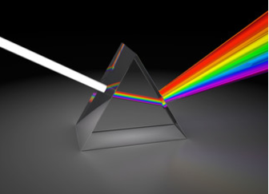

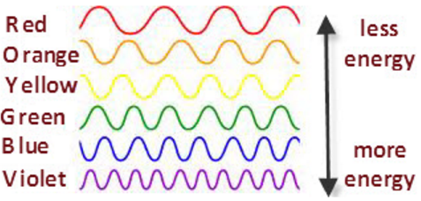
What gives light its color?
Visible and Invisible lights' colors are actually Frequencies. Each frequency is represented by a number.
Our eyes have adapted to see a different color for every existing frequency that is useful to us.
Colors are a trick played on us by our own brain to help us navigate the world around us.
In reality colors do not exist.
Either way, it's nicer to deal with colors than it would be to deal with the numbers each frequency has instead.
(NASA)
Each color has its own type of wave.
Some colors have loose, relaxed waves.
Other colors have a tighter, denser wave.
Every wave is given a number that tells you how dense the wave is. This number is called a Frequency.

Slide 6
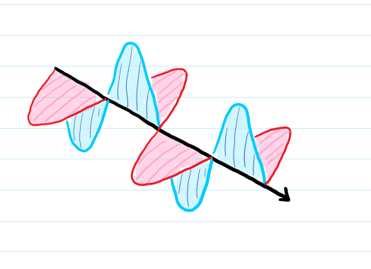
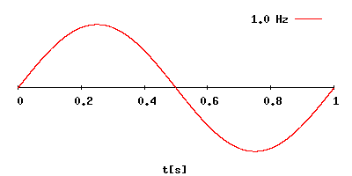
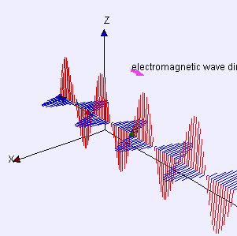
electric
Frequencies, what are they exactly?
magnetic
Frequencies relate to waves. But how?
Waves look like this:
This is a simplified version of a wave.
A light wave is actually made of two separate waves that work together and are perpendicular to each other.
One wave moves horizontally (here the pink)
The other wave moves vertically (the blue).
The two parts depend on each other: they are called the magnetic and the electric components.
That’s why light waves are also known as electromagnetic waves.
By Lookang many thanks to Fu-Kwun Hwang and author of Easy Java Simulation = Francisco Esquembre - Own work, CC BY-SA 3.0, https://commons.wikimedia.org/w/index.php?curid=16874302
This length is 1 second...
So what is a frequency then?
It’s a number that shows how frequently does the wave create a
new peak in one second.
Is the frequency of the wave in the animation growing or decreasing?
Answer: Increasing.
What is the relationship between the number of peaks and the number at the top (Hz)?
Answer: The number is equal to the peak count in the one second range.

Slide 7
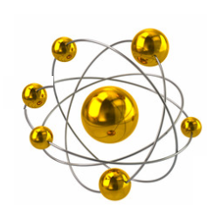

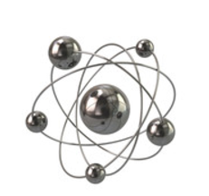
So we saw a frequency is both a color and a number.
Frequency also represents an amount of energy.
These packets of energy were given a special name so you always know how to say “the exact amount of energy of a specific light wave”: quanta.
Hey, me too!
Hi, I’m Quanta.
I only work with that guy, no one else.
I only work with that guy.
27873236
128828632

Slide 8
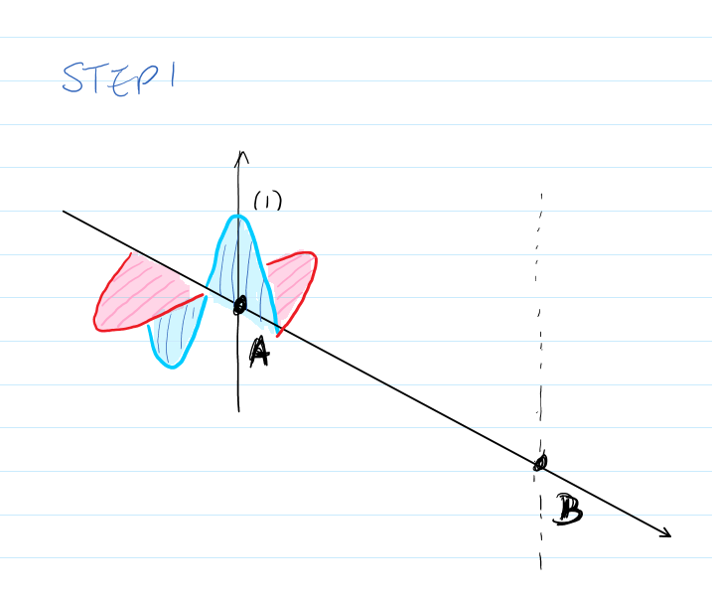
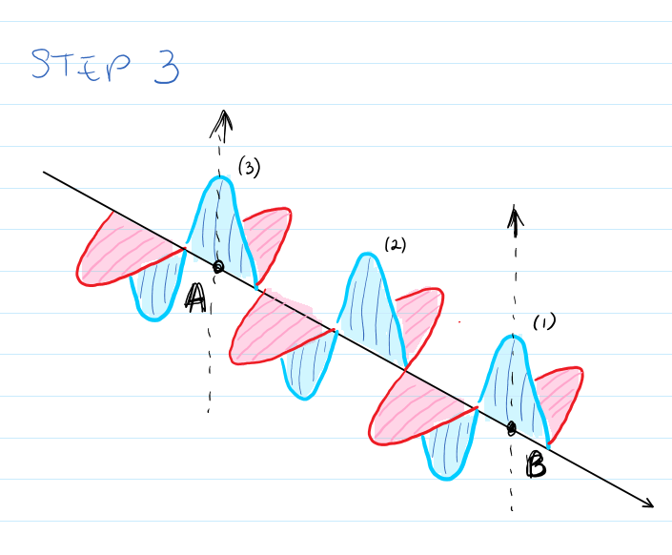
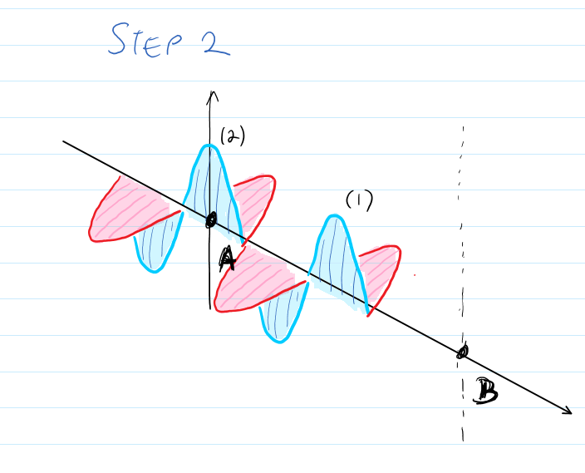
frequency = number = color = an energy amount (quanta)
As a number, the frequency represents the count of peaks seen through a single point during an amount of time.
Most often we focus on the simplest time interval: the duration of 1 second.
How does this happen?
How does the wave travel through one point?
Let’s say a wave moves along the line AB as shown next.
The first Crest, or Peak, to reach point A.
The direction of movement
Imagine the wave enters through point A.
Let’s say it takes Crest (1) exactly one second to arrive to point B.
As the wave moves forwards, another peak appears at point A.
Peak (2) is now where Peak (1) was a moment ago.
Finally, Peak (1) reached point B, the one second is up.
Count how many peaks traveled or touched point A in the given second?
The answer is: 3 peaks.

Slide 9
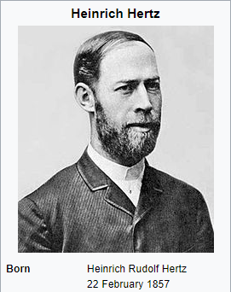
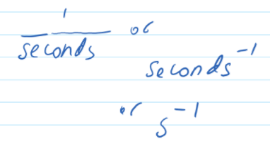

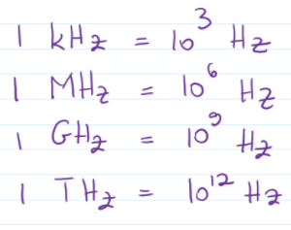

The Units of Frequency
There are several possible units.
Most often we want to say some number of waves in one second, or better known as "number of waves per second".
The unit was named to honor the scientist who proved the existence of light waves - which we now call electromagnetic waves.
In other words 1 over seconds is one of the possible units.
1 divided by the second is known as a “Hertz”
“Scaling” means to make it smaller or larger.
Scaling the unit up and down...
increasing...
Q: How many times is the unit increased by each step? (Express your answer as a multiplication of a power of 10)
Funny fact: In german the word for heart is HERZ. Pronounced the same as HERTZ but written a bit different.
And since one second is so close to the speed of one heartbeat, it’s a nice way to represent the “per second” concept.
Answer: Each increase is achieved by multiplying the previous number by

Slide 10
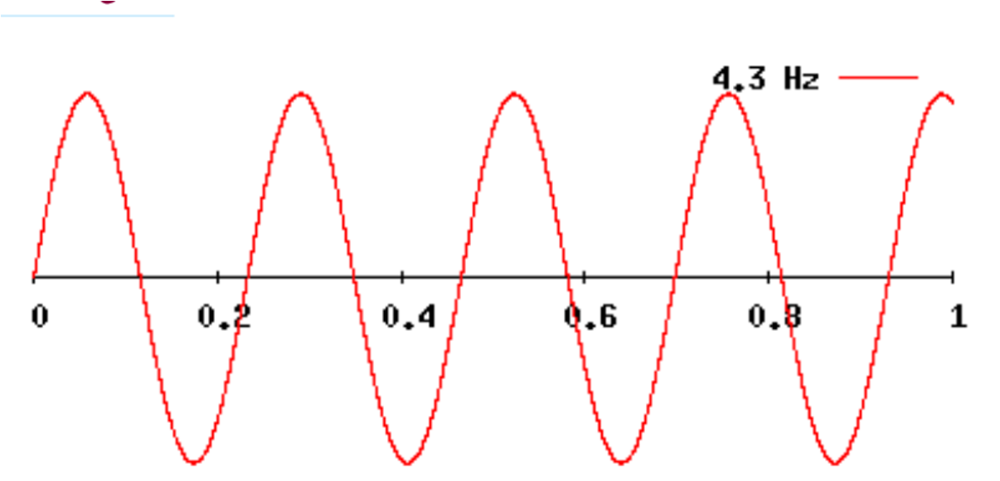

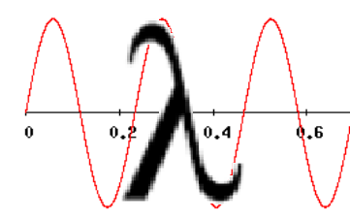
Q: As the frequency increases, what happens to the distance between peaks?
Answer: The distance between peaks becomes smaller.
Review
Notice the relationship between the number of peaks & frequency.
How would you measure the distance between peaks?
The more peaks appear throughout the given one second, the higher the frequency is.
Scientists like to use the greek letter lambda for this, because it looks a bit like a wave
or
This distance is called Wavelength.
You can either measure between the peaks (top) or between the troughs (bottom).
These two measurements should always give the same numbers.
If the wavelength measures a distance, what do you think its unit could be?
All units that measure distances are appropriate for wavelengths, a few examples are: kilometers, meters, centimeters, millimeters, nanometers.

Slide 11

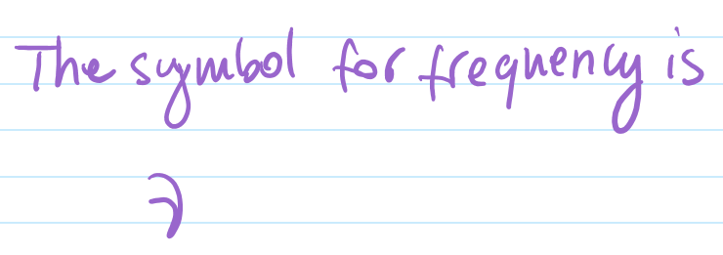
You saw the wavelength has the Greek symbol Lambda:
Scientists like to replace words, especially terms with letters. To avoid confusion with regular text, the letters used are typically Greek.
Does frequency has a symbol assigned as well?
Practice writing your Greek letters, it will come in handy later when you learn various formulas.
Of course. Frequency is assigned the Greek letter “nu”.
Units
You read earlier that frequency is measured in either waves per second (= waves/second), or in Hertz (Hz), and wavelengths are measured in meters or other units representing meter magnitudes (kilo-, milli-, nano-, etc.)
When plugging numbers into formulas, they must always be accompanied by their units.

Slide 12
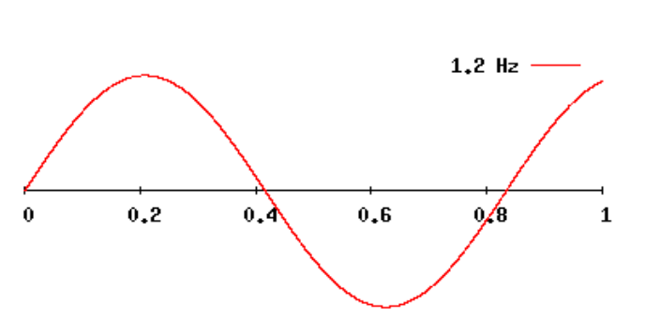
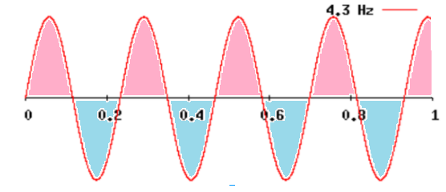
How should wavelengths be measured?
Let’s look at two different waves.
This is a peak to peak measurement.
wavelength
Same length
wavelength
Notice that both wavelengths happen in snapshots that are 1 second long.
There are other ways to measure the wavelength, you don’t have to use the peaks. For example the yellow arrow also works.
You have to make sure that:
you measure the parts that repeat fully,
all parts should overlaps exactly, and
you should have no pieces left over after overlapping them all.
The pink parts of the wave are covered just fine.
The blue elements are not covered at all, and thus the mistake.
The correct wavelength is rather:
Can the green arrows completely cover the parts that repeat? Can this be the wavelength?
The following is an example of how an incorrect measurement may occur:

Slide 13
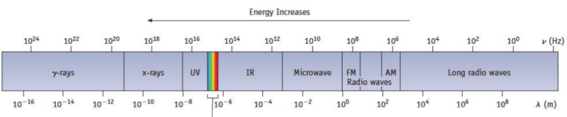
REVIEW
Remember that
- colors don't really exist but in our minds
- colors are actually frequencies
You can also say the diagram below places colors from left to right in increasing order of their wavelengths.
Each frequency is either a:
- visible color, or
- an invisible, or "weird" color if you want to call it that.
What word is missing from the next sentence?
The table below places colors from left to right in decreasing order of their ____________.
frequencies
We can say color, or we can say
ELECTROMAGNETIC RADIATION.
Wavelength Increases
If you sort frequencies from right to left in increasing order, you get the diagram above. Notice that groups of values have been bundled together.
Notice when sorting frequencies in order, all visible colors bundle together in the same continuous band trapped between the UV and IR groups.
The visible spectrum

Slide 14
End of Lesson.

