Slide 1
Chemistry for Kids
Unit 2/B
The Study of Light and Chemistry

Slide 2
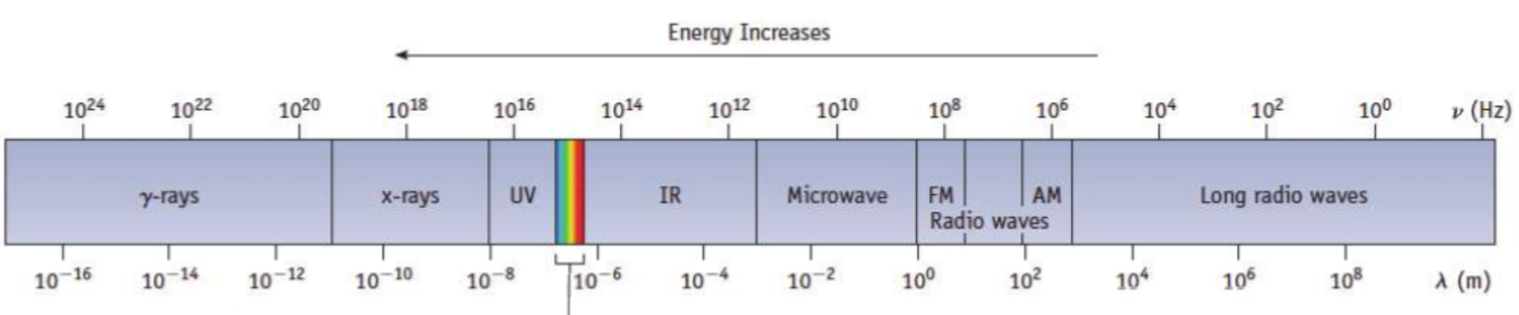
REVIEW
Remember that
- colors don't really exist but in our minds
- colors are actually frequencies
You can also say the diagram below places colors from left to right in increasing order of their wavelengths.
Each frequency is either a:
- visible color, or
- an invisible, or "weird" color if you want to call it that.
What word is missing from the next sentence?
The table below places colors from left to right in decreasing order of their ____________.
frequencies
We can say color, or we can say
ELECTROMAGNETIC RADIATION.
Wavelength Increases
If you sort frequencies from right to left in increasing order, you get the diagram above. Notice that groups of values have been bundled together.
Notice when sorting frequencies in order, all visible colors bundle together in the same continuous band trapped between the UV and IR groups.
The visible spectrum

Slide 3
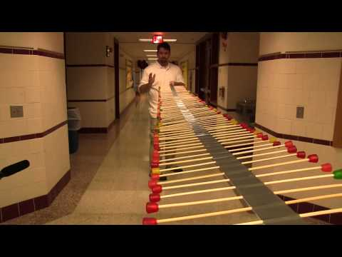
Wave simulation
https://phet.colorado.edu/sims/html/wave-on-a-string/latest/wave-on-a-string_en.html

Slide 4

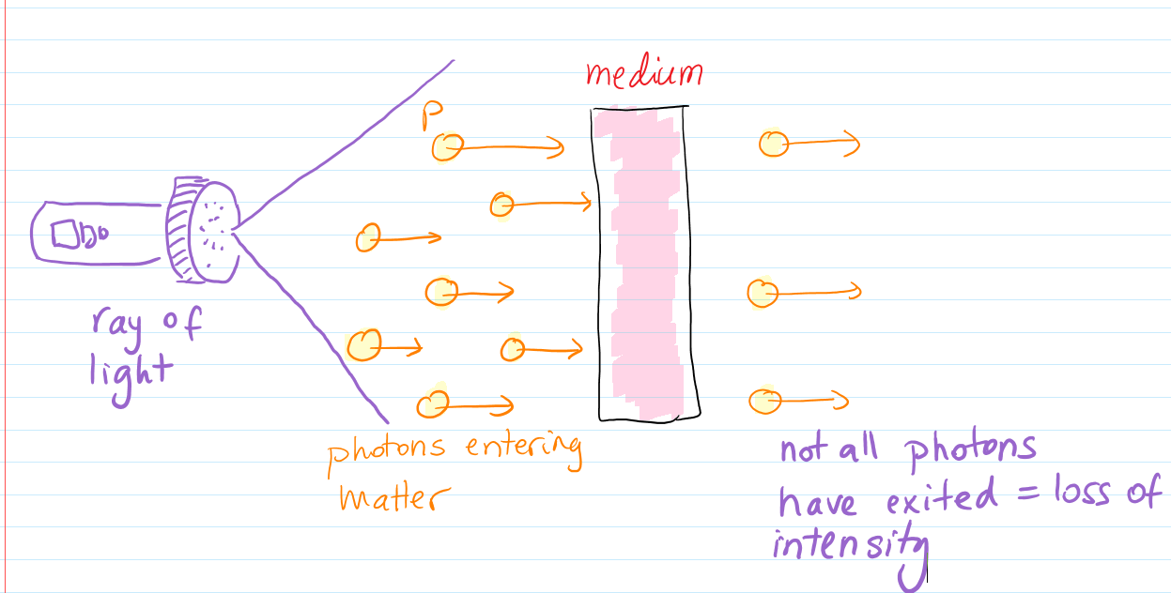

We talked about color, frequency, wavelength...
Q: So does Frequency have anything to do with Intensity?
Answer: Surprisingly nothing at all!
But where does the Intensity of light come from?
Intensity is formed by the abundance of photons.
That makes sense, you could say sometimes there is too much light...
That means a few number of photons will make dim light, and an extremely large number of photons will make light that blinds you.
Very bright beams are called Intense, or High Intensity.
The Energy of a single photon is NOT related to Intensity.
Intensity is nothing but a photon count.
Based on this image, what do you think “Attenuation” means?
89416562

Slide 5

Let’s look at Attenuation again...
“Medium” is just a way of saying a block of material made of something, we’re not sure of what.
It seems the medium is “consuming” some of the photons that are passing through.
Dimming,
Lower intensity photon count
The Intensity will be affected, there will be dimming on the right side as light exits the medium.
Like everything else, the medium is made of atoms.
It would be interesting to know what precisely inside the medium made the photons disappear.
What happened to the photons? Did they really get consumed?
What is happening here?
Large number of photons are entering the medium.
On exit, a lot of the photons are missing.
Formal definition:

Slide 6
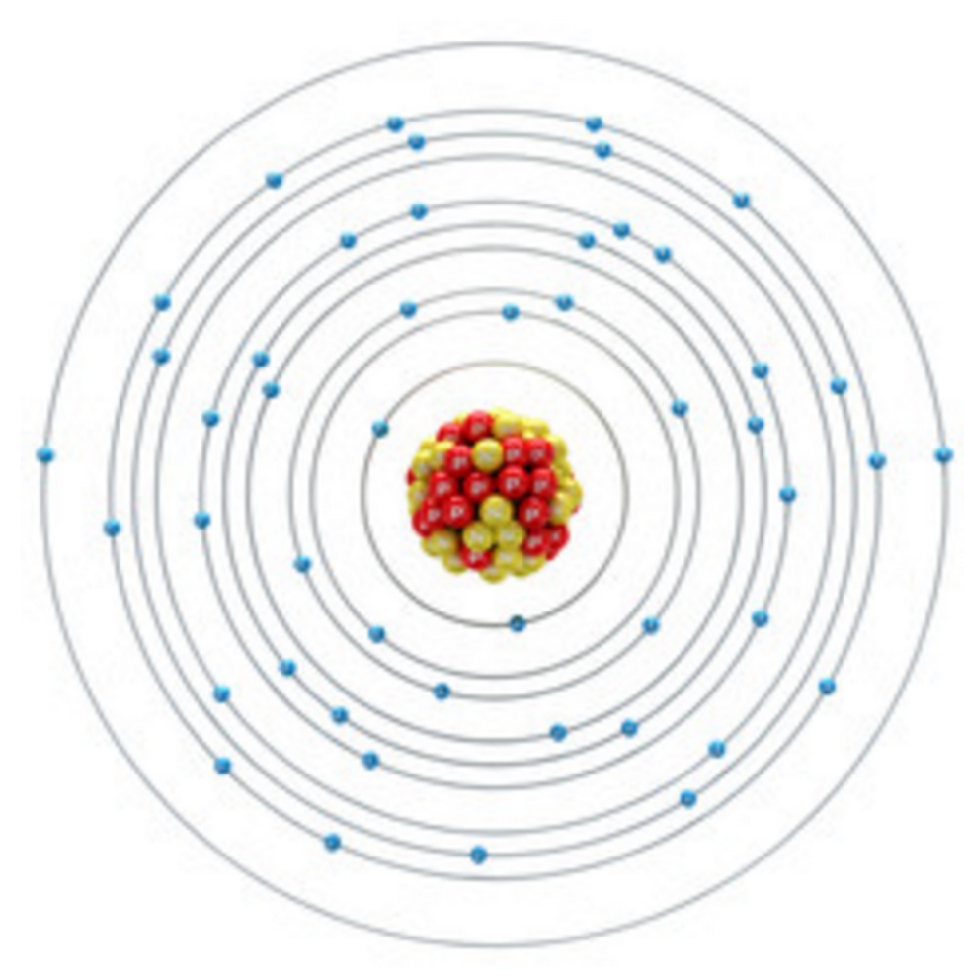
So, it got very weird…
But what can be learned from Attenuation?
Attenuation
Photons were consumed in some way...
Matter, or in other words the atoms that make matter, can “consume” energy that arrives in the form of electromagnetic radiation.
This radiation can be:
Visible light,
X-Rays,
Microwave radiation,
Radio waves, etc.
Who inside the atom could be responsible for the consumption of the photons?
It is the electrons!
Yup, these little massless bundles of energy

Slide 7

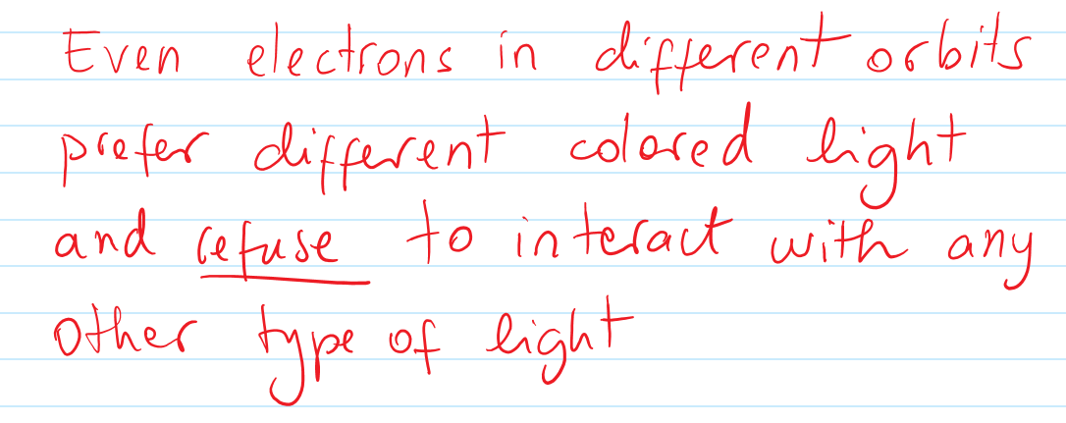
Electrons are finicky eaters...
known as the frequency...
Lower orbit
Higher orbit

Slide 8
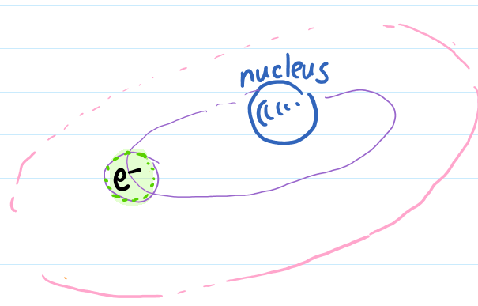
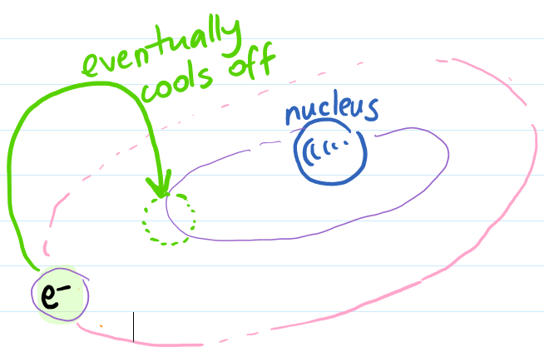
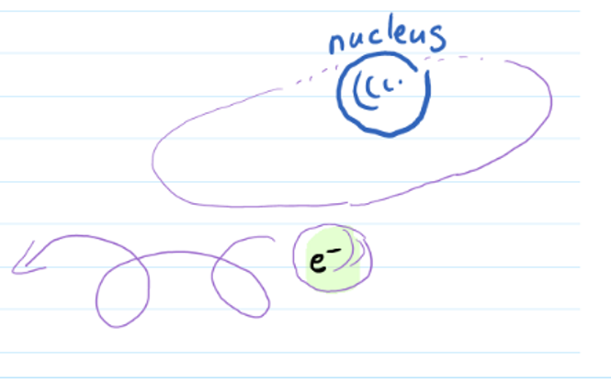
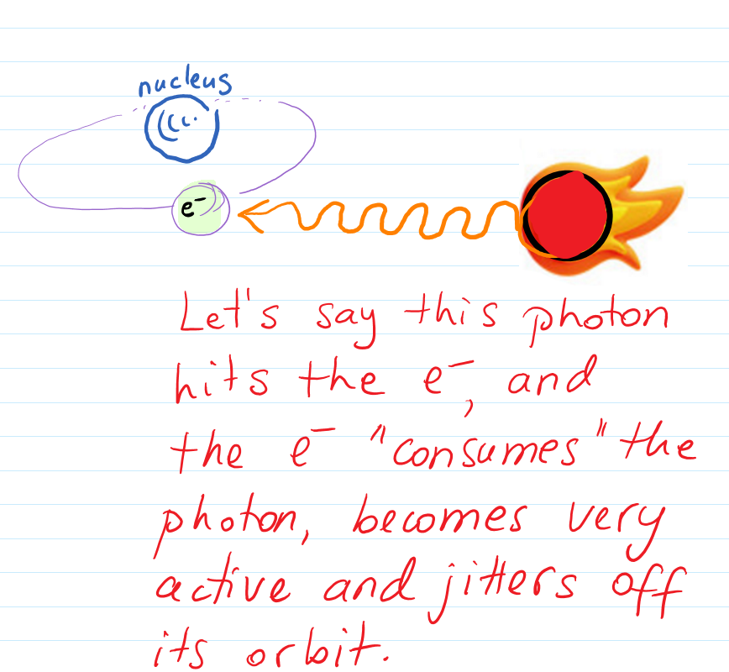
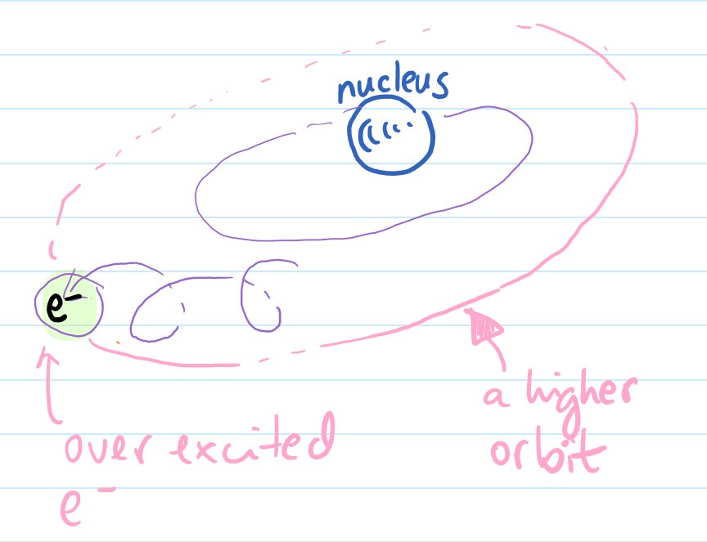
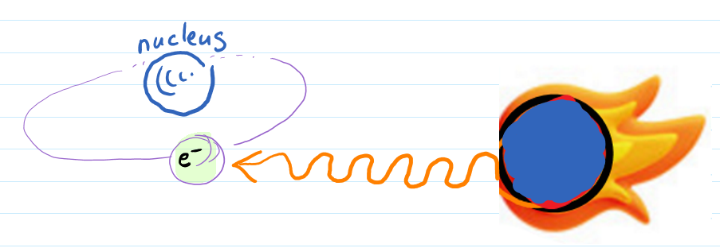
The electron eventually “cooled off” and descended back into its normal orbit.
What should happen if i hit the electron with a higher energy wave/photon?
Would the electron bounce off more energetically?
Not necessarily!
The electron will not react at all to a higher energy photon unless it likes its color.
What happens if a less energetic photon hits the electron? Is the reaction of the electron be more sluggish?
Like before, if the electron doesn’t like the color, it won’t budge at all. It won’t move slower, it will simply not react.

Slide 9
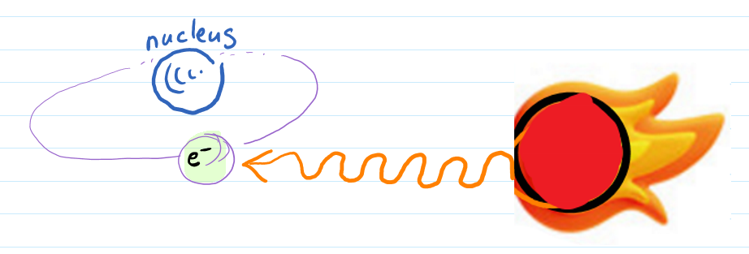
Once an e- has a “taste” for a certain color, no other type of wave will be interacted with.
The e- likes its favorite color to be as is, that precise frequency or quanta. Not higher, not lower.
Increasing the energy, or in other words changing the color of the wave, is not helpful in getting a stronger reaction.
The energy (= the color) of the preferred wave is called quanta. Think quantity to remember...
The word “quanta” is at the stem of the expression “Quantum Physics”.
Color = frequency = energy amount = quanta
Quanta is a specific amount of energy a photon has. It is a very small amount...
Frequencies are sorted in groups of
Electromagnetic radiation types
UV
Microwave
Radio
Visible light
X-ray
IR

Slide 10



Remembering...
Let’s take another look at the electromagnetic spectrum
Try to read this chart, and figure out which has the higher frequency: UV or Microwave?
Answer: UV
Which has the longer wavelength? X-Rays or Radio waves?
Answer: Radio waves
Compare two waves, a denser and a looser wave.
You can also think of these as more compressed or looser springs.

Slide 11
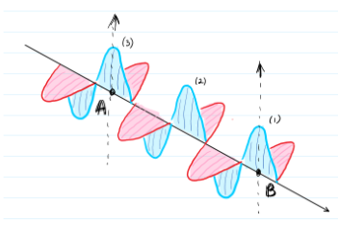
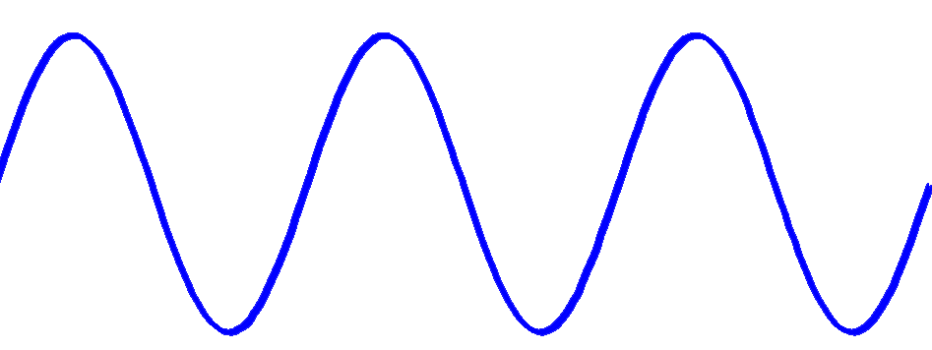
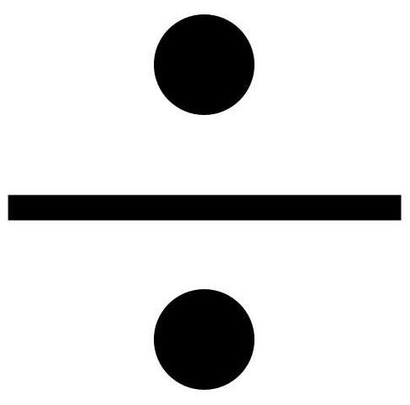


Is there any relationship between frequency and wavelength?
It seems that all light waves, no matter what color, travel at the same electromagnetic speed.
that is when not interfered with - meaning through the void of space, without any medium to stand in the way.
This speed is known as:
8
The speed of light: 2.998 x 10 m/s
Or approximately 300,000 km/s
In other words, for the duration of every second:
Let's say you first decide what your frequency should be. This examples uses a frequency of 3. It means we draw 3 peaks.
The 3 peaks happen in the a one second interval.
0
1
To draw exactly three peaks you must break the 1 second’s interval into 3 equal parts.
The distance traveled in that second = 300,000 km
100,000 km
The wavelength is a third of the distance traveled in one second.
The distance traveled in one second however is also the speed of light.
Then the following formula reveals itself:
1 second
Wavelength = speed of light frequency, or rather
The distance within the 1 second interval is 300,000 km. Dividing it by 3, or rather the frequency, gives 100,000 km for each piece. The pieces forms the wavelengths of this wave.
c
=
This forms one wavelength.

Slide 12
What would the previous exercise look like if we chose a frequency higher than 3?
All light waves travel at the speed of light:
2.998 x 10 m/s
Let's say you decide the frequency is 6 peaks instead of 3 this time.
8
6 is the number of peaks, known as the frequency. The 6 peaks happen within the one second interval.
Or approximately 300,000 km/s
Peaks: 1 2 3 4 5 6
To draw the 6 peaks you must break the interval into 6 equal parts.
0
1
The distance traveled in that second = 300,000 km
Like before, the wavelength resulted from the division of the distance traveled in 1 second into 6 equal parts, based on the formula:
1 second
Wavelength = speed of light frequency, or
The wavelength becomes 300,000 km 6 = 50,000 km.
c
=
The wavelength is the distance marked by the yellow arrow.

Slide 13
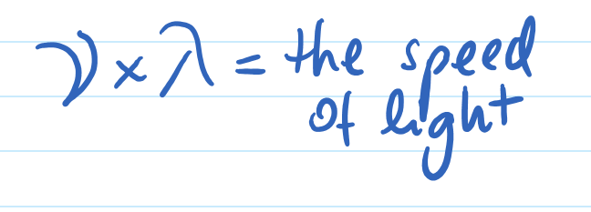
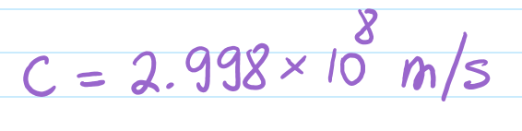
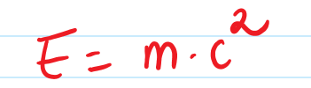


CONCLUSION: there is a relationship between frequency and wavelength.
For any colored light, if you multiply its frequency by its wavelength you always get the speed of light.
The speed of light is always the same number, never changes.
Another way to say this is that the speed of light is constant.
So what is the speed of light exactly, and what symbol have Physicists assigned to it?
The symbol assigned to light is the lower case c.
c stands for celeritas. It means speed in Latin.
Yes, that famous c from Einstein’s
Then any light wave, of any color, has a frequency that matches its wavelength into the same constant product: the speed of light.
Product means multiplication

Slide 14


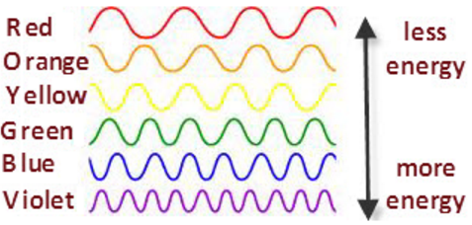
Let’s examine the trends
Between frequency and
wavelength:
Multiplying frequency and wavelength will always give you the same number
frequency
wavelength
This is a very large number!
Can both
and
be larger both at the same time?
TREND: look at the colors on the diagram, do you notice when frequency is high, wavelength becomes shorter and the other way around?
The larger the wavelength the lower the frequency.
Lower frequencies
Could this number be constant if both frequency and wavelength increase at the same time?
We’ll explore this question in the next slide.
Higher frequencies
Homework: Create a table of values for the formula above.
First assign values to the frequency and calculate the wavelength, then do the opposite: give values to the wavelength and calculate the frequency.
Higher frequencies have smaller wavelengths.
Violet has higher frequency than red.
But a shorter wavelength.
How do the other wavelengths and frequencies compare to each other?

Slide 15
Let’s experiment with multiplying series of numbers for frequencies and wavelengths.
Make the series increase, then decrease, examine the multiplication results.
Draw arrows to show the increasing/decreasing trends, have the tip of the arrow point to the largest numbers.
Let’s look at some examples:
This is precisely the trend for nu and lambda too. It’s the only way to result in multiplication result that is a constant.
Both trends are increasing numbers. What is then the trend of the results, increasing or decreasing?
Both trends are decreasing numbers. What is then the trend of the multiplication result?
1 x 5 = 5
2 x 6 = 12
3 x 7 = 21
4 x 8 = 28, etc.
10 x 5 = 50
9 x 4 = 36
8 x 3 = 24
7 x 2 = 14, etc.
If nu and lambda were both increasing (see red arrows), then their product, i.e. the speed of light, would be increasingly higher, but we know that the speed of light is constant.
Results have an increasing trend in the direction of the arrow.
Results have a decreasing trend in the direction of the arrow.
Opposites multiplied: one increases the other decreases, what is the trend of the multiplication result this time?
If nu and lambda were both decreasing (see blue arrows), then their product, i.e. the speed of light, would be decreasing too, but we know that the speed of light is constant.
9 x 9 = 81
8 x 10.125 = 81
7 x 11.57 = 81
6 x 13.5 = 81
If the first number is decreasing, then the second number has to increase to continue to get 81.
The quickest way to remember the correct trend is: frequency (nu) and wavelength (lambda) have opposite trends, when one increases the other decreases, and their product (multiplication) is always the same.
Stays constant

Slide 16
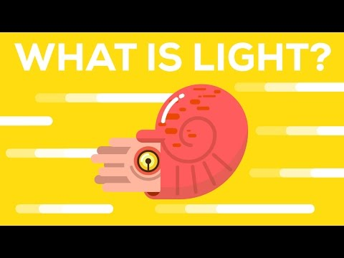
You Will Need Pen and Paper...
Read the questions before watching the video and write down the answers.
(4:40 minutes)

Slide 17
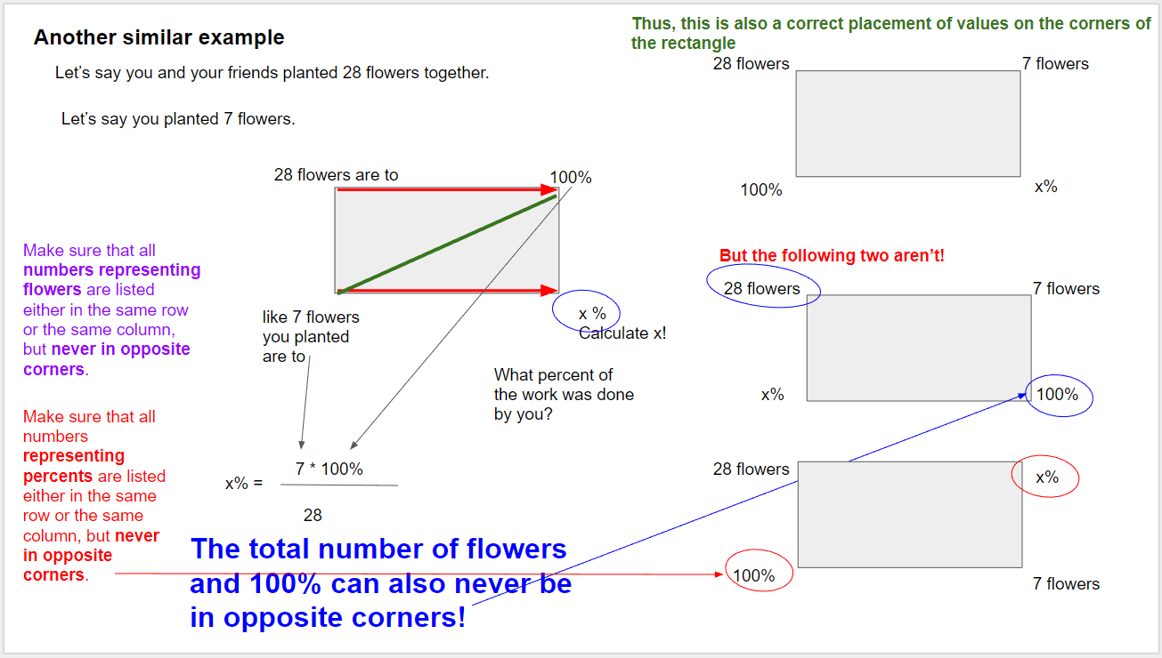
MATH REVIEW:
Before you continue to the next slide, makes sure you review a bit of Math from the previous volume: isolating a variable.

Slide 18
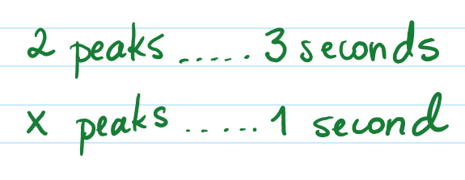
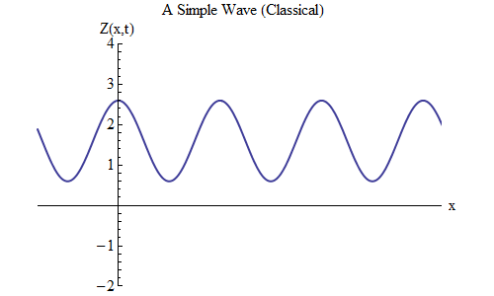
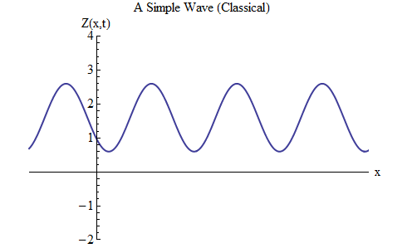
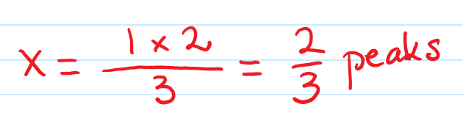
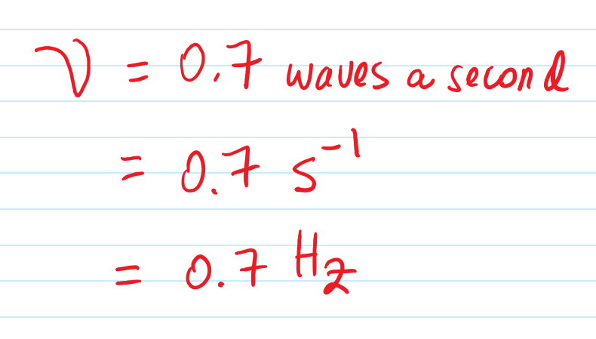
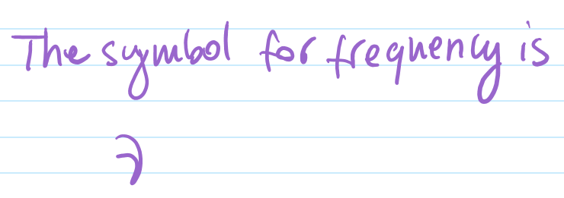
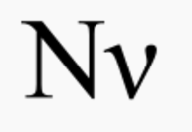
FREQUENCIES Exercise
I counted 3 seconds. How about you?
Let’s pick the tip of the orange arrow as a point of reference.
So we can see 2 peaks every 3 seconds. What is the frequency then?
The wave will start moving in a moment.
When the first peak touches the arrow, start counting seconds, you can use: one Mississippi, two Mississippi,etc.
Count how many seconds pass until the next peak touches the arrow.
Make sure you reviewed the Math suggested on the previous page!
=0.666...
Click the mouse to start the wave moving...
Therefore the frequency is approximately 0.7 waves/second.
These are the Greek letter “nu” upper and lower case symbols:
this unit can also be written as
waves per second is also equivalent to

Slide 19
Practice, you’ll need a calculator:
Try on your own first, then solutions are available on the next slide.
Math you need to review for this:
Exponents
Isolating variables.
Both these strategies are listed in the previous volume.

Slide 20
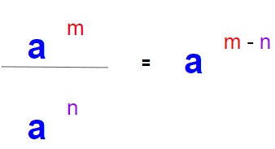
You’ll need a calculator:
Solution to Q1:
For any wave, we know the frequency x wavelength product results in the constant that is the speed of light
8
*
= c
= 2.998 x 10 m/s
Isolate the wavelength from the formula
The frequency is given
m
8
8
2.998
10
8
s
c
2.998 x 10 m/s
2.998 x 10 m/s
x
=
=
=
=
=
-14
-14
1.54
10
1
1.54 x 10 1/s
s
Handle the units as if they were numbers.
a Hz is the same as 1/s. You want the second instead of the Hz b/c it is more consistent with the upper units which is also given in seconds.
Use the exponent rules from the previous volume to manage the exponents
=
8-(-14)
s
1.95
x
10
m
x
s
1
=
24
1.95
x
10
m
This unit is correct. Indeed wavelengths are measured as distances.

Slide 21
You’ll need a calculator:
For any wave, we know the frequency x wavelength product results in the constant that is the speed of light
8
*
= c
= 2.998 x 10 m/s
c
8
8
8
2.998 x 10 m/s
2.998 x 10 m/s
=
2.998 x 10 m/s
=
=
=
=
9
520 nm
520 x 10 m
Inconsistent units
m
1
8-9
1
-1
=
0.0058
x
10
m
x
3
3 - 1
2
m
=
5.8
x
10
x
10
1
=
5.8
x
10 Hz
=
5.8
x
10 Hz
s
s
A better way to express this number is as
5.8 x 10
3
-1
s = Hz
=
5.8
2
x
10 Hz
We’ll learn more about how to express the precision of calculations in the next volume.

Slide 22
End of Lesson.

