Slide 1
Chemistry for Kids
Unit 3
Units, Precision, SigFigs

Slide 2
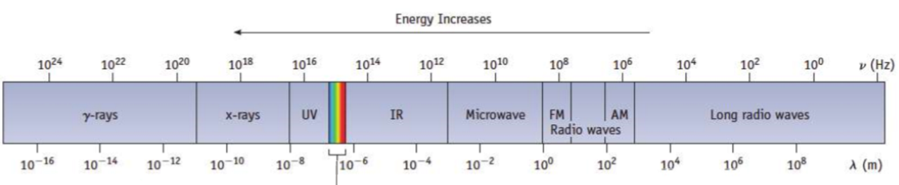
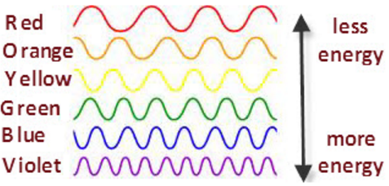
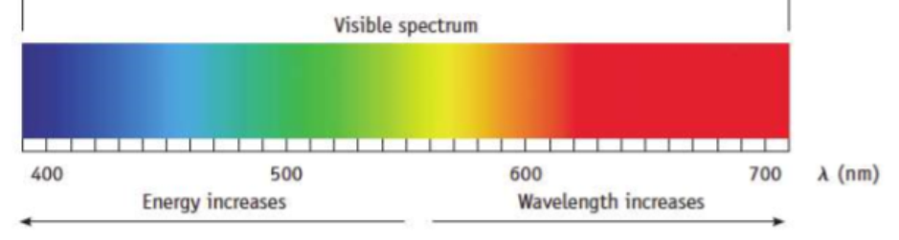
Let’s review
Another way to look at this is:
OR

Slide 3
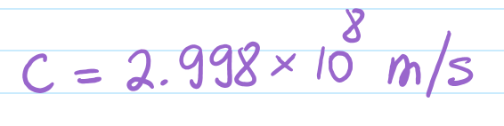
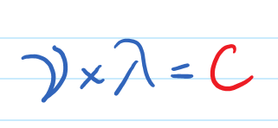
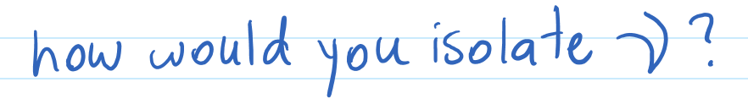
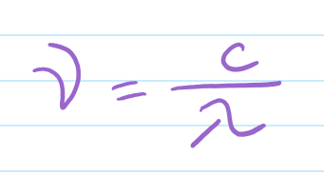
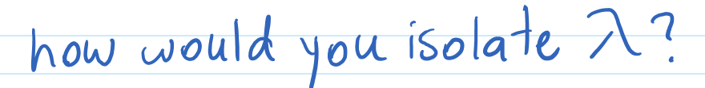
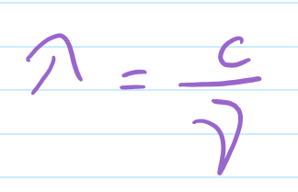
Memorize the speed of light:
You need a bit of Math here, use equations to isolate a variable from the equation...
What is a formula that involves the frequency, wavelength, and the speed of light? This formula was given in the previous volume...
Consider this formula to be part of the same family of facts as the relation above.
When plugging numbers into these formulas, you must be sure that the units for each value are consistent.
Example1: Let’s say a value for the wavelength is given, and your task is to calculate the frequency.
Example 2: Can you use the wavelength in km if the speed of light used is in m/s?
Answer: No.
Do all units in Example 2 form a consistent framework?
That means
don’t use the speed of light in km/h unless your wavelength is measured in km and you convert the hour to seconds.
don’t use the speed of light in m/s unless your wavelength is measured in m.

Slide 4


Units, are they ever a problem?
Let's look at an example, blue waves are approximately 400 nm of wavelength, and remember the speed of light is:
that is: c = 299,800,000 m/s
convert the units from m/s to km/s so the number is shorter:
this is also equivalent to c = 299,800 km/s
From the previous page, we
know that we can express the frequency as:
So let’s calculate the frequency of this blue light using the speed of light and the wavelength above.
But which value should I use?
The blue?
299,800,000 m/s
Or the red?
=
749,500
and we are hoping these are both Hz, right ?
(A Hz is a unit defined as 1/second, see the previous volume for more information on Hz).
400 nm
How would the two calculations, blue and red be different?
c
c
=
=
=
299,800 km/s
=
749.5
400 nm
400 nm
Next, plug in the number for c

Slide 5
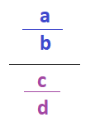

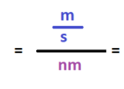


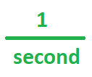



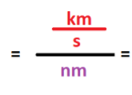


When calculating formulas, units must always accompany the numbers.
This division, or fraction line becomes multiplication (*), and the fraction below turns upside down.
You need a bit of Math here, remember how fractions behave when divided or multiplied...
Then if identical units appear in fractions, they can be simplified just like numbers. Let’s see how this may work for the blue & red calculation from the previous slide:
Blue calculation
The two results cannot be simplified further.
Also, don’t forget that any number can be written as a fraction by expressing it as the number over 1:
The rule to use here
is described by:
But neither looks like a Hz =
So something went wrong. What could it be?
Are the units used in the blue and red calculations consistent?
Blue: m, s, nm
Red: km, s, nm
Use the same fraction rules to finish the Red calculation:
Answer: NO! meters were mixed with nm in the blue and km were mixed with nm in the red. All units for distances should be the same: either all m, all nm, or all km.
Let’s take a look at how when used correctly, units will simplify into what we want, in this case a Hz = 1/second.

Slide 6


So neither blue nor red calculations were correct!
The following is the correct calculation instead:
Let’s convert
m → nm.
We know that:
CAN’T STOP HERE THOUGH!
We need a unit conversion to match all distances to the same unit. What should the unit be? m or nm?
remember the wavelength of the blue light was 400 nm
9
1 m = 10 nm
c
c
Doesn’t matter:
m to nm is ok, and nm to m is also ok, as long as we are consistent throughout the entire calculation using the same unit rather than both units in the same expression...
=
=
=
299,800,000 m/s
400 nm
400 nm
Then 299,800,000 m has to be multiplied by:
10 nm
9
9
The extra 10
Simplify the fraction by 100
*
*
After division by 4
COMPARE how much larger the frequency is now in the correct result than the red and blue calculations before! The units used make a huge difference.
749,500
= 749,500,000,000,000 Hz
749.5

Slide 7
Analyze! What was the problem? Why were the results so different each time?
The units were inconsistent.
How do you know you are using the right units?
Most units are part of the same consistent framework, for example:
Length | Mass | Time
m | kg | s
mm | g | s
Example table of consistent units
https://femci.gsfc.nasa.gov/units/
Time often stays the same, for example speed = distance divided by time, can change from m/s to mm/s but the seconds do not need to change.
Each row is its own framework of units...
Whenever learning new formulas in Chemistry, Physics or Biology, the new formula is always presented with its standard units, from there you just follow that setup. See an example of such a formula on the next page.

Slide 8

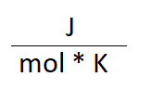
Example Formula and How the Units Are Given
Once the formula and its units are given, you can double check the units are part of a consistent unit framework.
In this example there are:
Pascals,
m,
mol,
Kelvins
You don’t have to understand the formula below, for this exercise just track how the information is given and the way the units are tagging along.
Ideal Gas Law Formula:
These don’t create any inconsistencies. Alternately if you had km and Pascal-s, you would need to change for ex. the km into m. Other changes are possible, the end result must always be a consistent framework.
Typically, next the letters in the formula are given a meaning:
P (Pascals)
P = pressure,
V = volume,
n = a mole count
R = the ideal gas constant
T = temperature
mol
3
m
K (Kelvins)

Slide 9
Units Review
What is longer, a meter or a kilometer?
a kilometer
What is heavier, a gram or a kilogram?
a kilogram
What does KILO mean?
“Kilo” is a unit prefix that shows you the magnitude of a number.
In Greek it means thousand.
Unit prefixes save us from writing out very large numbers.
For example, instead of 1,000 m it is shorter to say 1 Km.

Slide 10
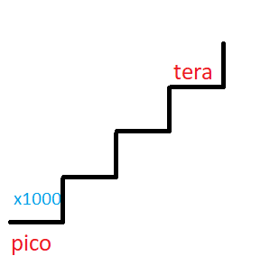
How do we change the magnitude?
The magnitude is otherwise known as the Unit Prefix.
Homework: draw a stair diagram and place the units and their magnitudes on the stairs to show the transition from one unit to the other.
All examples here are Metric, as opposed to the Imperial version of prefixes.
Here are a few common prefixes
certain steps between prefixes are larger
and other steps are smaller.
x1000
x1000
x10
x10
x1000
and so on...
x1000
deci centi milli micro nano pico femto
d c m μ n p f
tera giga mega kilo hecto deca
T G M k h da
Larger values
Smaller
values
x10
x10
x10
x10
Let’s say the pink square is some number with NO magnitude in the unit. Some examples are: meter, Joule, Newton, gram, etc.

Slide 11
How do unit prefixes make numbers shorter?
1 km = 1,000 m = 10³ m
In both cases we were able to contract
1,000 (a.k.a 10³) and replace them with only 1 using the k- prefix.
1 kJ = 1,000 J = 10³ J
How does it work in reverse?
J to kJ, and
m to km
1 m = 10ˉ³km = 0.001 km
1 m = ? km
1 J = 10ˉ³kJ = 0.001 kJ
1 J = ? kJ
The conclusion: applying the unit prefix for k is:
k[something] = something * 10³
Where something is a unit like: m, Joule, Pascal, g, etc.

Slide 12
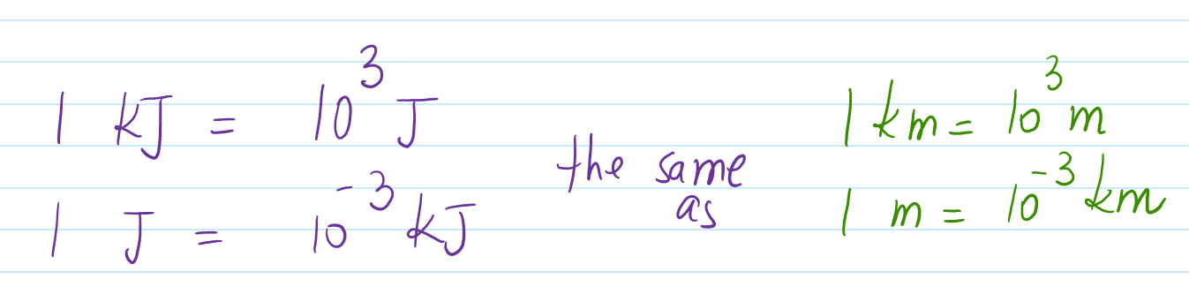
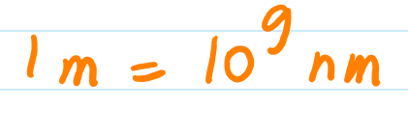
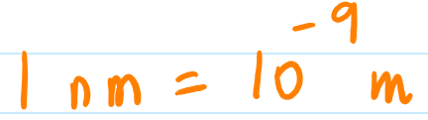
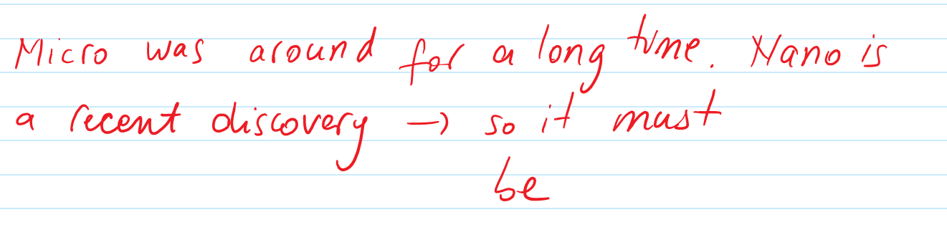

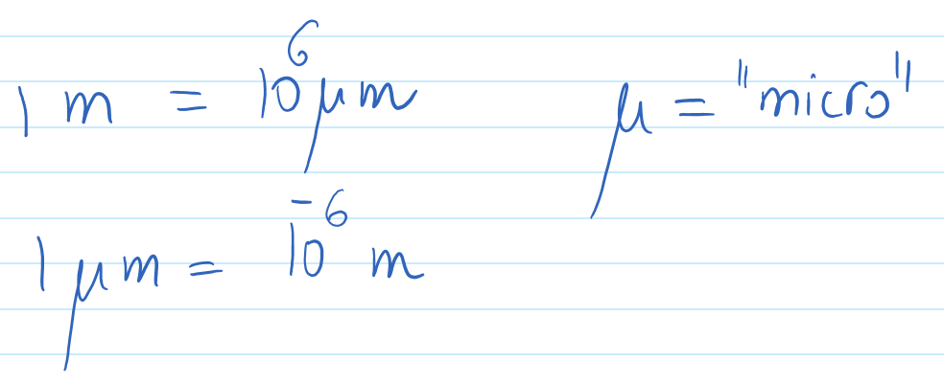
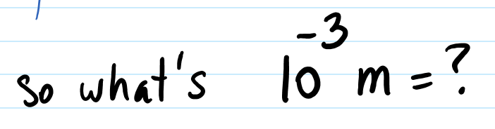
How do we memorize unit prefixes?
Kilo
Different units, same prefix, same magnitude
One meter is made of many smaller nano units.
For ex.:
In
reverse
In reverse
Example unit prefixes: Giga, Kilo, Mega, centi, milli, micro, nano, etc.
= 0.000000001 m
Learn the exponent that goes from one prefix to the other, it’s always going to be the same.
nano
smaller
Because we have better microscopes now...
First think we you are scaling up or down?
Here the negative power means the number is actually 0.001m, so it’s a smaller part of a meter.
Take your time and think your way through the problem!
A thousandth of a meter to be precise.
The answer is: 1 millimeter

Slide 13
Unit Conversions
The magnitude here is the prefix: kilo for example.
In computers you probably used Giga-, Mega- and Tera- prefixes. These are the magnitudes of the unit.
Many exercises present units in random magnitudes and it is your job to make sure the units used in formula calculations are consistent.
Let’s say a problem states a few values for: an energy, a distance and a mass using the following unit magnitudes
Typically you should convert these magnitudes to a consistent set:
kJ (kilo Joules)
km (kilometer)
g (grams)
J (Joules)
m (meters)
kg (kilograms)

Slide 14
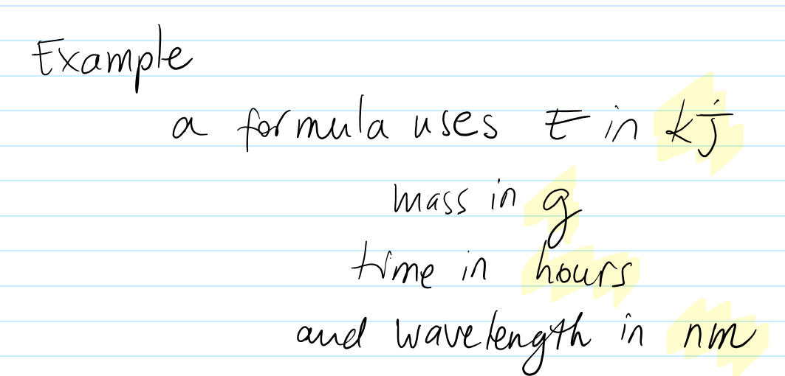
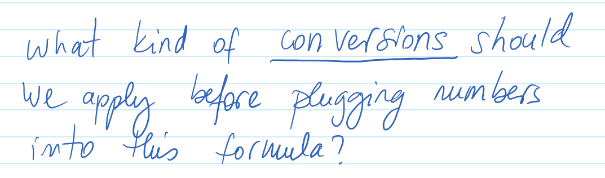
Are these elements in a consistent framework of units?
(energy)
no.
element | units as given initially
Energy | kJ
mass | g
time | h
wavelength | nm
To solve convert to
J
kg
s
m
conversion factor
x 10³
x 10ˉ³
X 60
x 10ˉ⁹
more
less
When you convert, try to imagine if you should have more pieces or less pieces in the results.
For ex. if you had kJ, remember that kilo- is a way to shorten the units and write less. Then when you convert to J (instead of kJ), you should have more,or rather larger numbers. You are going from a more compact form to a looser form.
The opposite is true about converting from g to kg, your numbers should become smaller as the prefix k- is helping you contract, or shorten your numbers. It should seem like there are fewer pieces after the unit prefix kilo- is applied to account for the contraction.

Slide 15
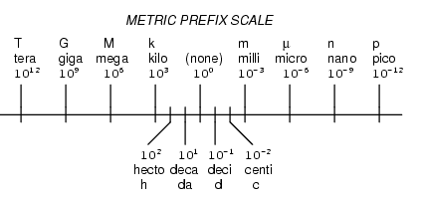
Exercises:
Reminder scale. All conversions are in relation to the no prefix value in the middle rather than in relation to each other
Convert 6.589 cm into mm
Convert 345,789,009,876,789,087 m into Gm.
Convert 1,000,000,000,000 L into μL.
Convert 60 mph into m/s
(Try on your own first, answers are on the next page)
Conversion rates listed on the right are from each unit to the center (none), not the other way around! For example:
1 μL = 10ˉ⁶L
And in reverse:
1 L = 10⁶L
Make sure to notice when to use negative exponents.

Slide 16
Exercises, Solutions:
Conversion rates listed on the right are from each unit to the center (none), not the other way around! For example:
Ex 1. Convert 6.589 cm into mm
cm to mm get multiplied by 10.
Thus the answer is 65.89 mm
1 μL = 10ˉ⁶L
And in reverse:
1 L = 10⁶L
Ex 2. Convert 345,789,009,876,789,087 m into Gm.
Make sure to notice when to use negative exponents.
m into Gm convert by dividing the meter by 10⁹.
Ex 3. Convert 1,000,000,000,000 L into μL.
345,789,009,876,789,087
There are a lot of Liters already in the original number, and now we want to convert it to counting even more parts, so the number will get even larger.
Let’s write the original number as an exponent:
1,000,000,000,000 L = 10¹² L, this is only compacting by exponent, not by unit conversion
To convert L to μL we multiply by 10⁶.
Notice we are converting L to μL, not the other way around.
So you would lose 9 zeroes worth of positions.
345,789,009.876,789,087
And after round off, let’s say I decide to keep 2 decimal points:
345,789,009.88 Gm

Slide 17
Exercises, Solutions:
Conversion rates listed on the right are from each unit to the center (none), not the other way around! For example:
Ex 4. Convert 60 mph into m/s
First what is mph?
It’s meters per hour.
1 μL = 10ˉ⁶L
And in reverse:
1 L = 10⁶L
If you travel 60 meters in an hour, how many meters is that in one second?
Make sure to notice when to use negative exponents.
In other words
60m
1 hour = 60 minutes = 60 x 60 seconds = 3,600 seconds
60 m
=
So 60 meters happen in 3,600 seconds
Then one second has 60 m/3600 seconds = 0.016666 m/s
Rounding off to 3 decimal points gives us 0.017 m/s
1 hour
3,600 seconds
60
=
m/s
= 0.017 m/s
3,600

Slide 18
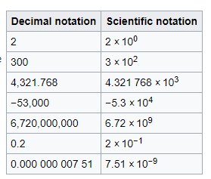

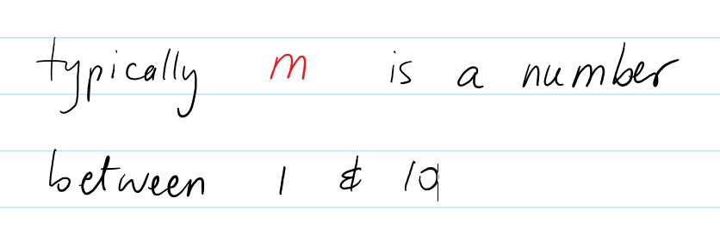
Scientific Notation
https://en.wikipedia.org/wiki/Scientific_notation#Further_examples_of_scientific_notation

Slide 19
SigFigs, what are they?
Many calculation (vs. measurement) in Chemistry yield decimal point results with a very long trailing list of digits. For example:
5.86284857867798787121
We don’t want to use such a long number, so we want to round it.
However before rounding, ask yourself if this is the result of a measurement.
If the digits result from calculations, then may not be so important and can be chopped.
But they are considered to be significant if represent real life measurements but then there are rules about how you can chop and round them in calculations.
Calculations in Chemistry and Physics need to preserve all significant figures (digits) and there are a few rules to help you with that.
First we have to learn how to count the number of significant digits in a number.
Before you can count them, know how to identify them.

Slide 20
SigFigs, which digits of a number are they?
Notice the number 5.86 284857867798787121 of a measurement has no zeroes at all.
This is the easiest case as all non-zero digits are considered to be significant and should be counted.
What about zeroes?
Not all zeroes are considered to be significant, thus not all should be counted.
There are three kinds of zeros as far as sig figs are concerned:
Trapped zero - surrounded by non zero digits.
Leading zeroes - appear at the beginning of a number, typically when there is a decimal point.
Trailing zeroes - appear at the end of the number.

Slide 21
Counting Significant ZEROES
Case 1: Trapped Zeroes
The easiest to recognized are trapped zeroes:
1.9087
30.508
They are surrounded by non-zero digits so easy to recognize. All such are considered significant digits and should be counted.
Case 2: Leading Zeroes
Leading zeroes are also very easy to recognize as they appear in the front of the number:
0.2
0.01987
0.000508
All such are not considered significant digits and should NOT be counted.
Case 3: Trailing Zeroes
While trailing zeroes are easy to recognize at the end of a number, they are not always considered significant.
Trailing zeroes are considered significant ONLY if a decimal point is present.
Here are some examples:
2.0
200
200.
200.000
Not a measurement but a calculation, yet it has one more position of precision. Where would this precision come from if I only measured one decimal point? It’s a false precision that should be removed.
All these trailing zeroes are significant b/c the decimal point is present
2.9 x 2.9 = 8.41
The two zeroes are not significant because no decimal point is present
measurement
Sig figs are very important in calculations b/c the result of a calculation can not be more precise than ANY OF the participating numbers with the lesser precision!
Before dealing with calculations you have to be able to count the significant digits in any number

Slide 22
Sig fig counting, Exercises:
Let’s color the significant figures red or blue.
Take a look at the following numbers,
25
503
0.9
7800
0.05680
42413.5689
9,001,600,789
9,001,600,78900
0.000087504
80,000
100.0
0.009802580
42.00
0.0010300
Zeroes trapped between other digits are always significant
25
503
0.9
7800
0.05680
42413.5689
9,001,600,789
9,001,600,78900
0.000087504
80,000
100.0
0.009802580
42.00
All non-zero digits are significant
Do not add zeros as placeholders at the end of a number if there is a decimal point. Such zeros are considered significant and will mislead the precision.
All leading zeros are insignificant
Trailing zeros are insignificant when there is no decimal point.
Zeros after the decimal point are always significant
Read more...
http://chemistry.bd.psu.edu/jircitano/sigfigs.html
Now that you know how to count sig figs, let’s see how they affect calculation magnitudes or precisions, and how should results be chopped, or rounded.

Slide 23
Sig Figs in addition/subtraction
http://chemistry.bd.psu.edu/jircitano/sigfigs.html
5.8608 + 2.17 = ?
The result can not be more precise than the number with the lesser precision!
4
2
Steps:
Count the sig figs in each of the participating numbers, but only in the parts that appear after the decimal point.
Red has 4 sig figs,
and the blue has 2 after the decimal point.
2. Remember the lowest count, n = 2.
3. Add the number with no constraints
8.0308
4. The result must contain the same number of digits
in the decimal part as n. Chop accordingly but first round the parts chopped to the rightmost position.
8.03

Slide 24
Sig Figs and Multiplication(/Division)
The result can not be more precise than the number with the lesser precision!
5.86928 * 2.187 = ?
6
4
Step 1: Count the number of sig Figs in both numbers and choose the lower one, we’ll name it n.
In this case n = 4.
Step 2: Perform the calculation as is
Here the result is 12.83611536
Step 3: Chop off after n=4 significant digits, but first round up/down the removed parts
12.83611536
12.84
4

Slide 25
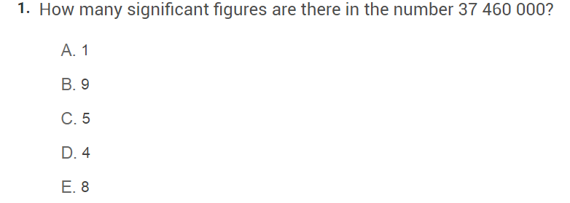
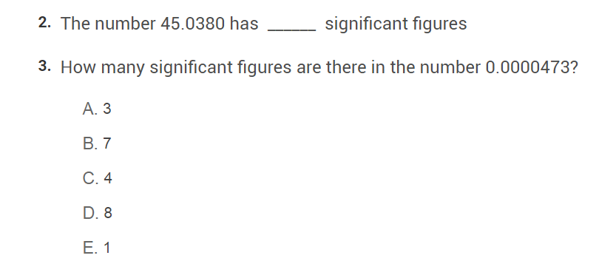
https://www.proprofs.com/quiz-school/story.php?title=significant-figures-rounding
quiz
6

Slide 26
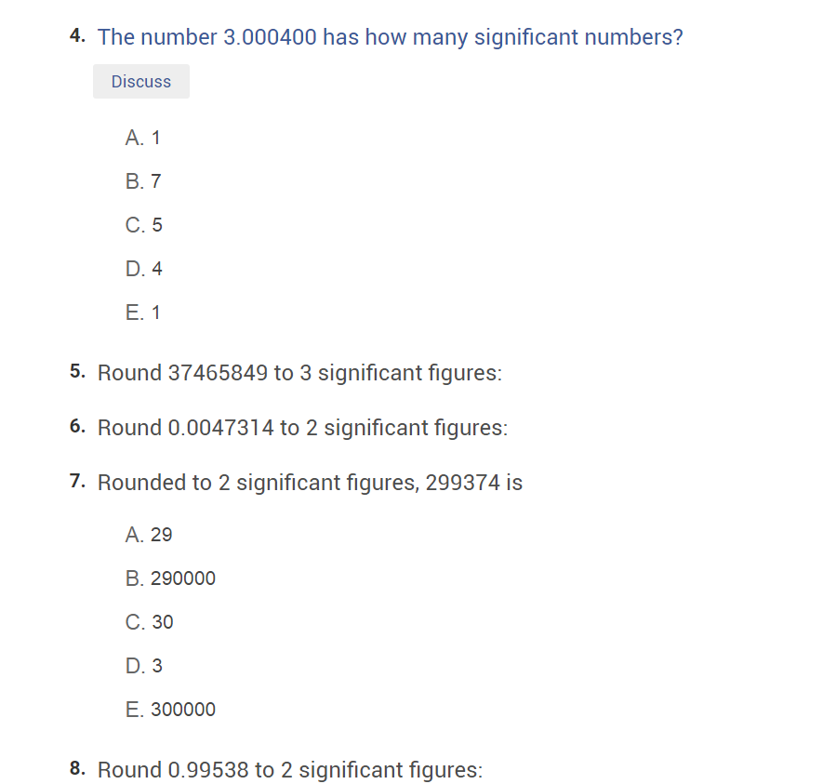
37500000
0.0047
5
3.0 * 10 would have been better.
1.0

Slide 27
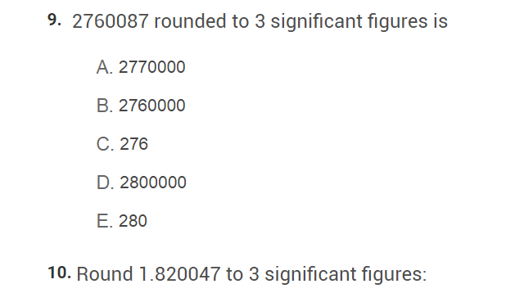
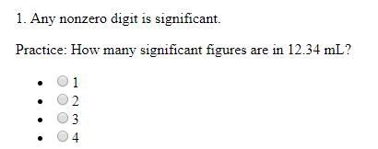
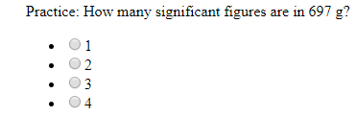
1.82
http://www.mrwiggersci.com/chem/Tutorials/Ch2-Interact-Pract-Sig-Figs-Blacksburg.htm

Slide 28
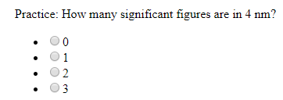
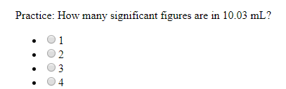
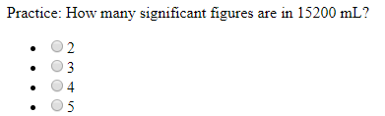
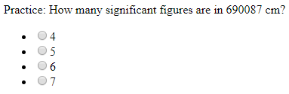
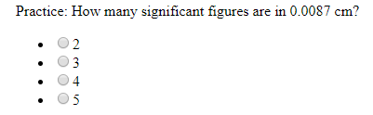
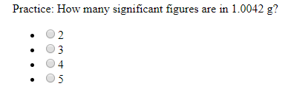
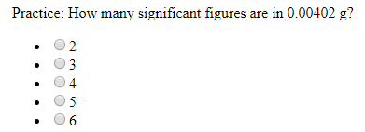
-9
4 nm = 4 x 10 m has nothing to do with it...

Slide 29
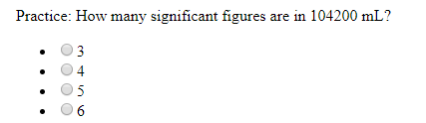
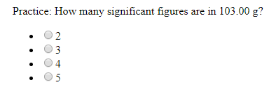
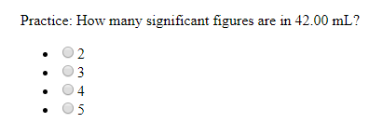
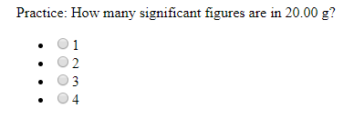
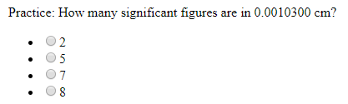

Slide 30
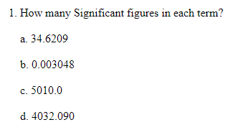

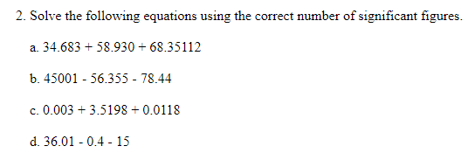

http://www.chemistry.wustl.edu/~coursedev/Online%20tutorials/Plink/sigfigkey.htm
See Slide #23 for the algorithm how to.

Slide 31
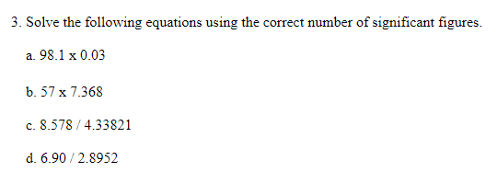
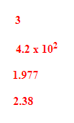
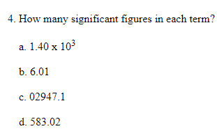

419.976 needs to sig figs. 420 or 4.2 x 100
Chop here for 2 digits

Slide 32
https://www.sophia.org/tutorials/adding-and-subtracting-using-significant-figures--2
1
Any number
How should 1 impact the sig figs of the results?
If 1 is not result of a measurement, you can assume that 1 has infinite precision, thus should not impact the result.
Same goes for say
21 * number
If 21 is a conceptually solid constant that originates from logic, not from measurement, then it can be seen of infinite precision.
More reading at
https://www.kpu.ca/sites/default/files/downloads/signfig.pdf

Slide 33
End of lesson.

