Slide 1
Chemistry for kids
Unit 04

Slide 2
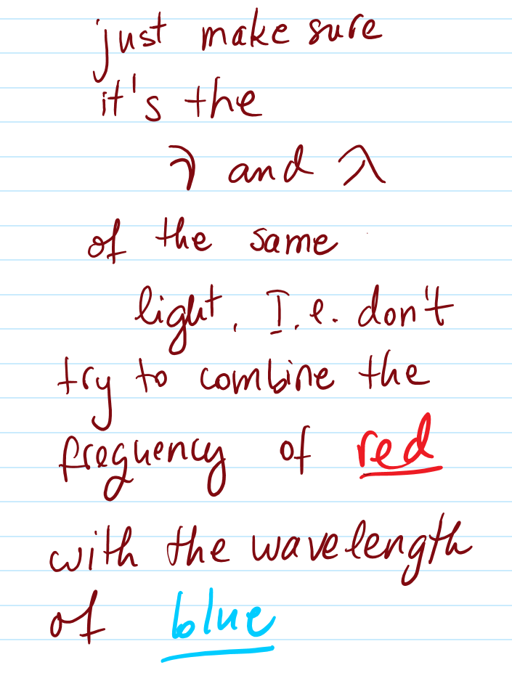
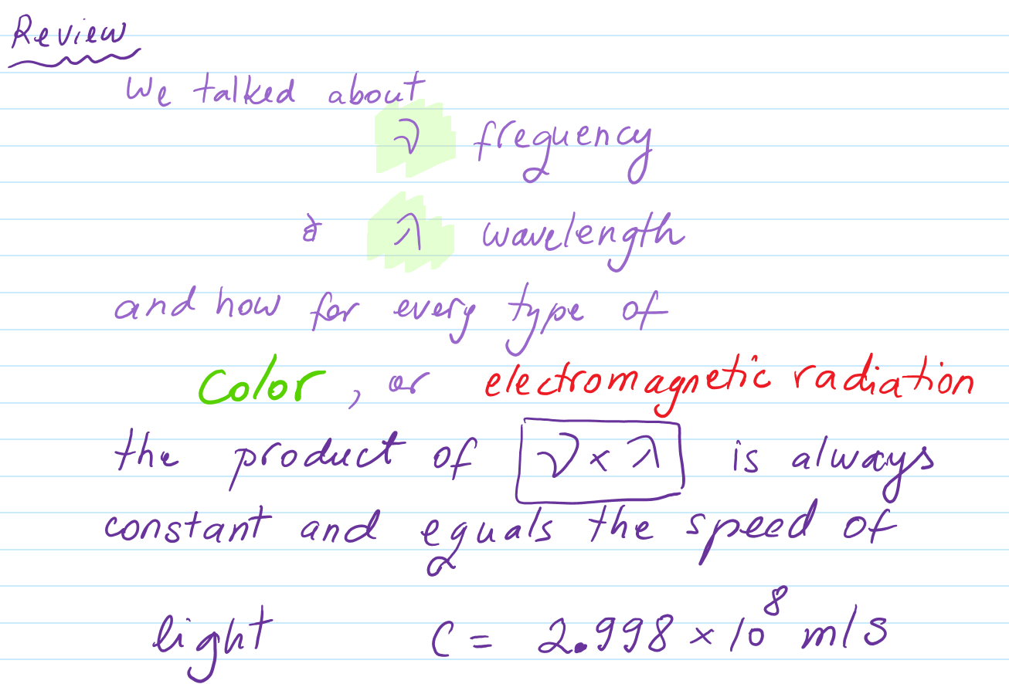
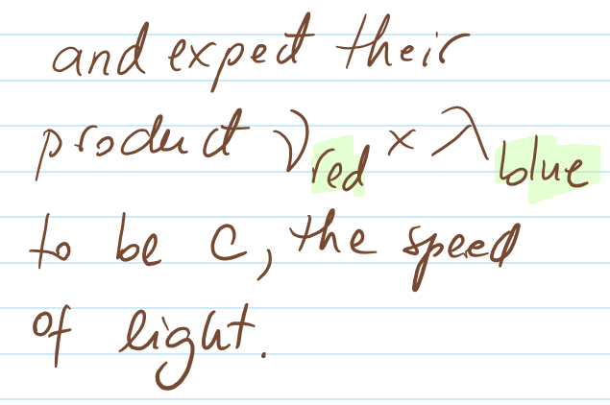

nu
lambda
accelerate

Slide 3
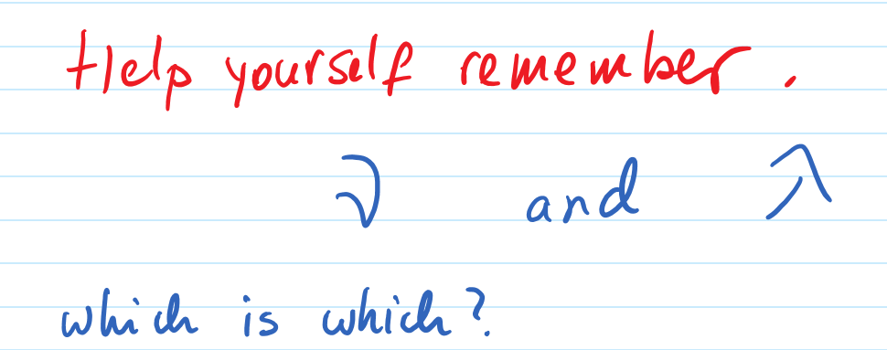
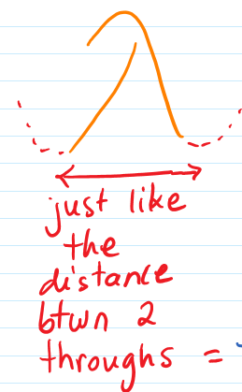
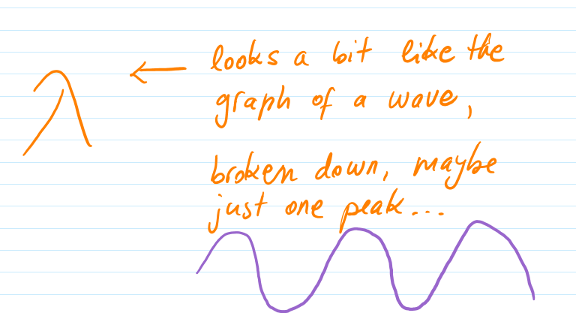
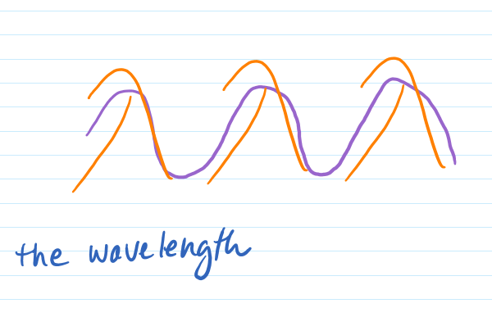

Slide 4




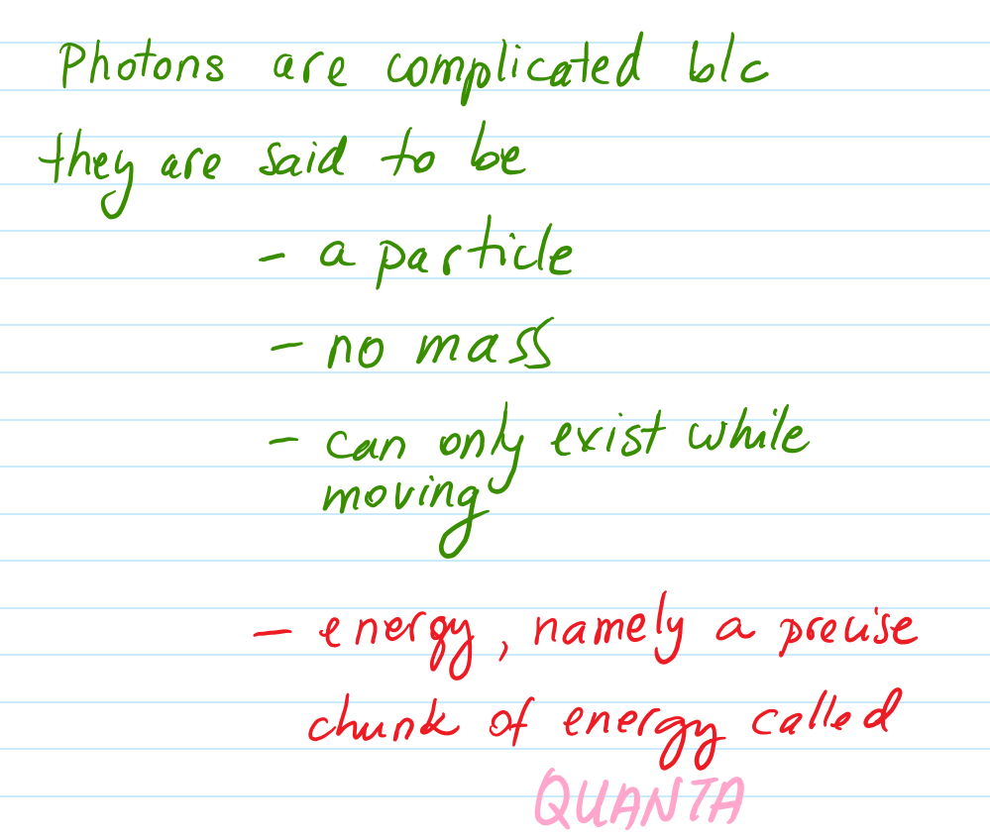
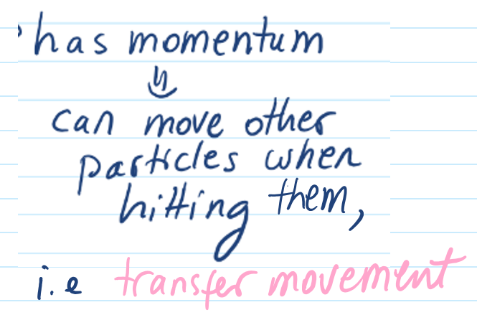
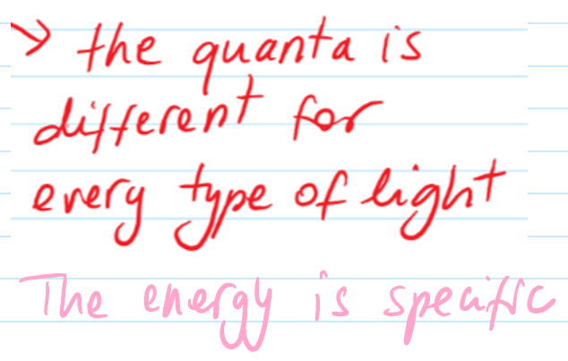
http://www.askamathematician.com/2010/09/q-how-can-photons-have-energy-and-momentum-but-no-mass/

Slide 5




So a photon has no mass but it has momentum. What is that?
m = the mass of an object
v = its speed
So if mass is zero, momentum should be zero too.
But that is not the case.
So how would this work for photons hitting matter?
You can already suspect that the photon does not obey the regular laws of Physics, but rather a different set of laws: Quantum mechanics.
This also interesting because momentum is conserved. That means if an object hits another, the sum of their momentum-s before and after the collision must be the same. Here is how this happens in Newtonian Physics. Remember that photons can hit things as well....
Elastic collision, identical mass
Elastic head-on collision, by a larger mass
Plastic/inelastic collision, identical masses

Slide 6


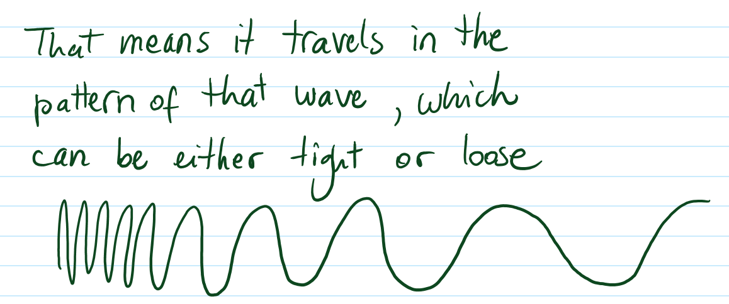
v

Slide 7
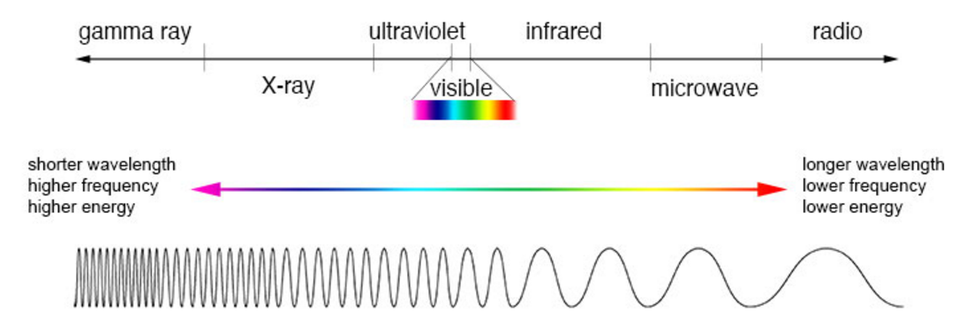
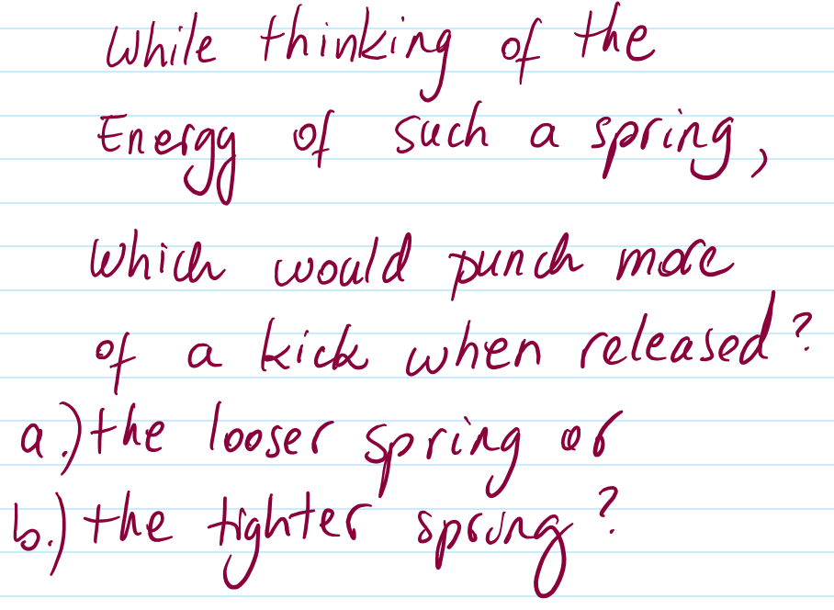
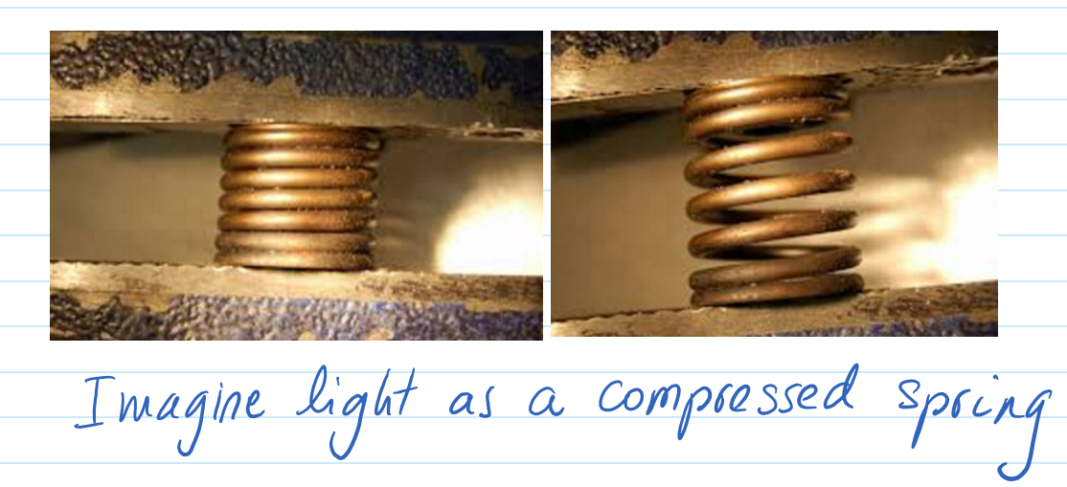
looser
tighter
ouch!

Slide 8
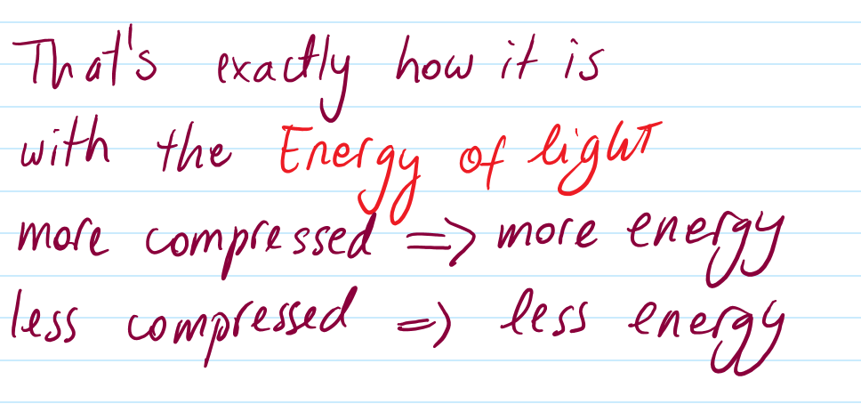
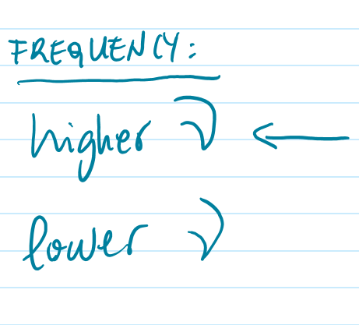


Slide 9
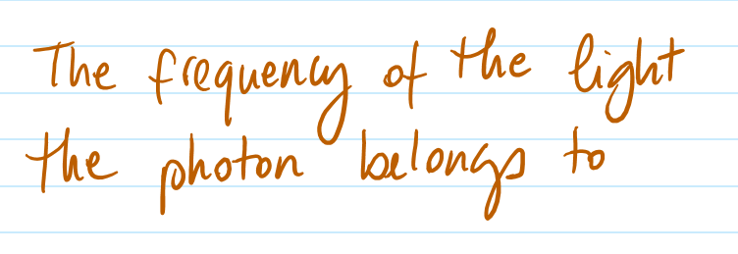

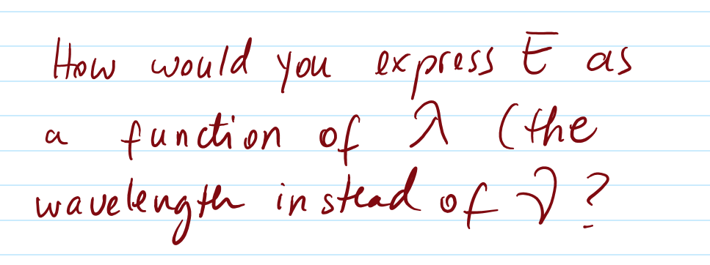
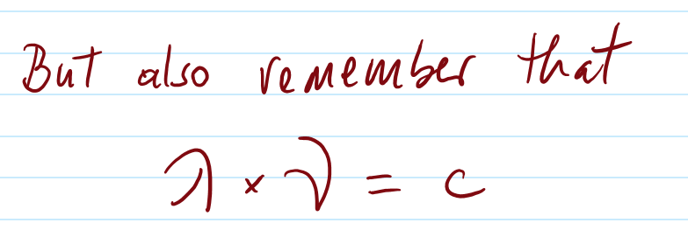
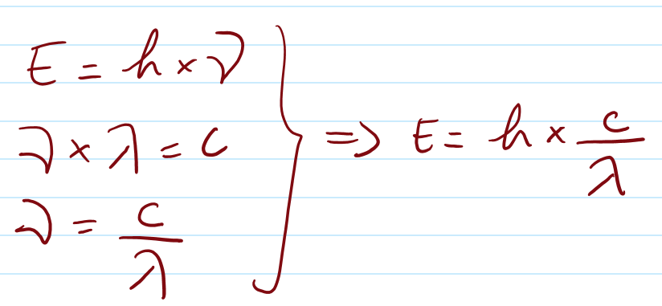
Every photon belongs/or is a specific wave frequency.
No matter what kind of light, this part is always the same.
answer:

Slide 10

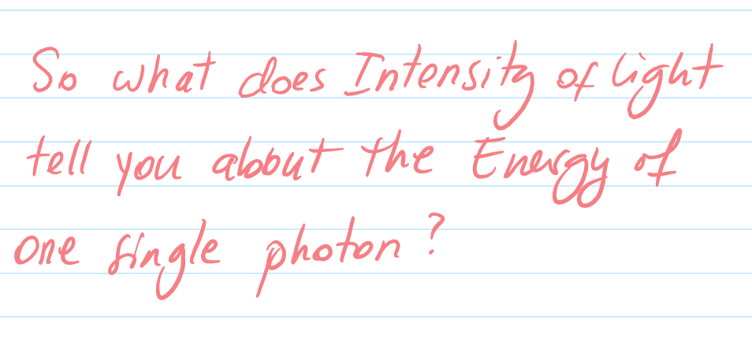

Energy of one photon

Slide 11
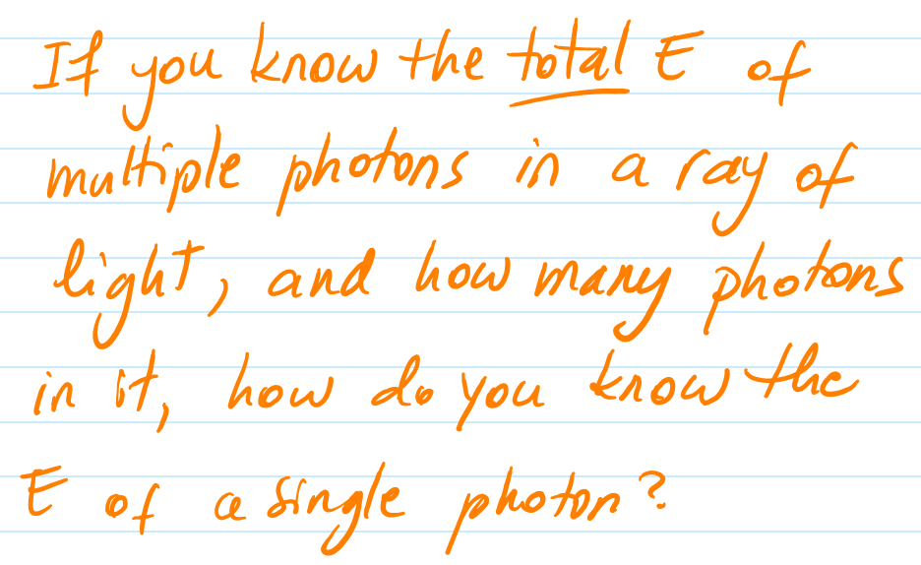
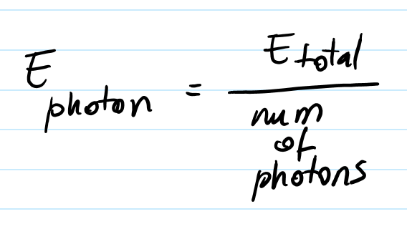
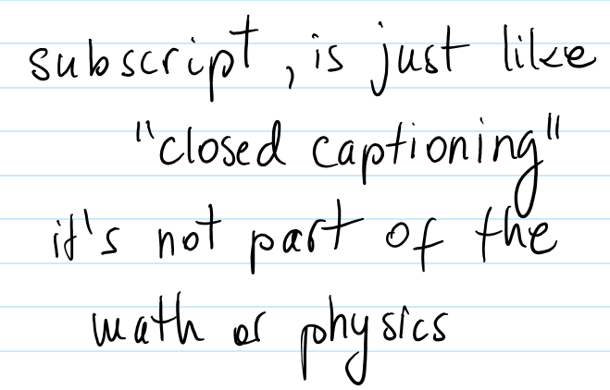



Slide 12




Safe unit framework?

Slide 13
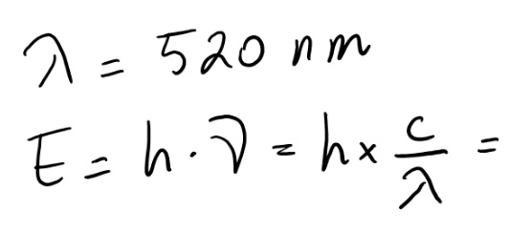




Slide 14




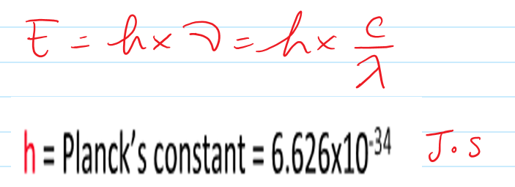
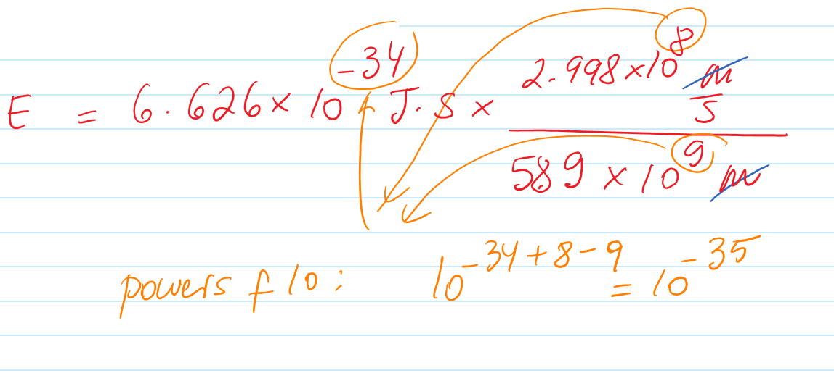

Slide 15




