Slide 1
Chemistry for kids
Unit 05

Slide 2
SIG FIGS - Significant Figures...
Other times you may want the front to be the same kind, for example
2.13 vs. 32.85
But then when you throw in two different exponents, say
Numbers with extremely large/small exponent already
indulge in zeroes inside the exponent, we don’t need them at the front or end of the number as well…
7.8 x 10
28
65
34
5
0.000009657 x 10
2.13 x 10 vs. 32.85 x 10
34
It becomes clear that even though 32.85 is obviously larger than 2.13 it is still the lesser number.
This is because 2.13 has such a terrible magnitude in its exponent.
Nice numbers look like this: 2.13 x 10
38
Not 0.000213 x 10
Just adjust the exponent.
We can have a bit of variation
34
Sometimes you want to see 2.13 x 10
Other times you may want to see 21.3 x 10
Try to be consistent with the data given (not the known constants which are verbose with zeroes) and match your answers to the data your calculations depend on the most.
Other times, format your numbers depending on what you are trying to compare...
33
If you wanted to show than one number is much larger/smaller than another, then you may want to adjust so that they have the same exponent, and compare the rest easier.
Observation: The larger the front number you convert to, the lesser the exponent must be.

Slide 3
Getting the Sig Figs wrong, will reduce grade points from your labs, for sure!
Examples, format the number correctly
65
4
0.000009657 x 10 assume this is a result that depends on 1.23 x 10
-15
-8
0.00001456 x 10 assume this is a result that depends on 4.8 x 10

Slide 4
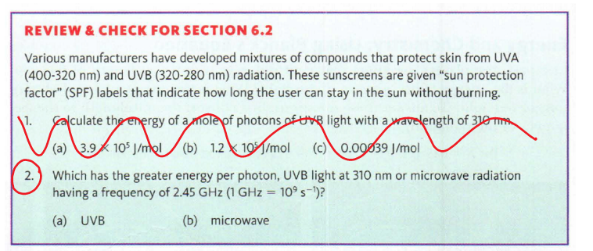


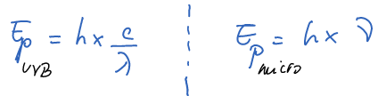
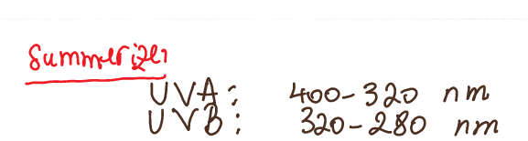

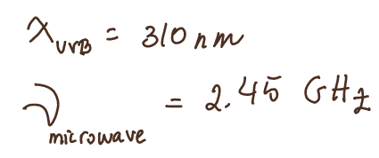

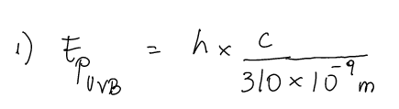


HOW do we solve something like this...
State the problem in short mathematical format
b/c:
Evolve this further on the next page

Slide 5

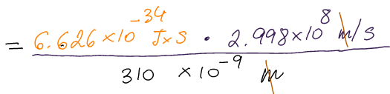
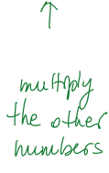
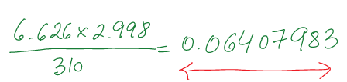
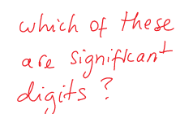
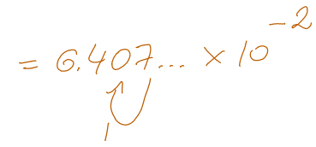
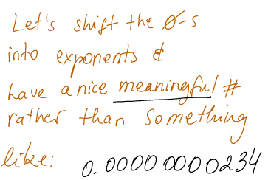
Deal with the exponent first
=?
What did your data depend on? The constants c and h?
I want to know how far the “6” is -> I will use an exponent for that
No. Rather 310, the wavelength in nm,
The front zeroes are bothering me. I’m already using exponents, should I still trail those zeroes in the front?
-2
6.41 x 10
Which one of these is correct?
-2
6.4 x 10
B/c the result should also have this many number of digits, i.e : 3.

Slide 6
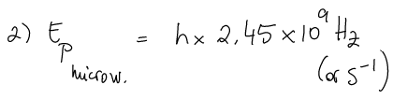
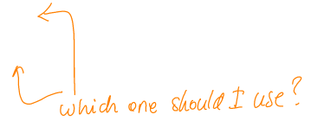
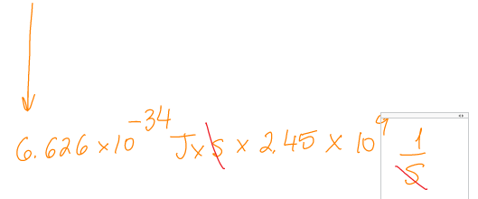

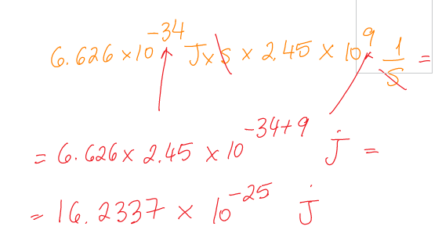
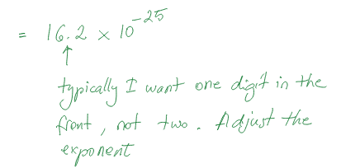



What data does this result depend on?
That gives u 3 sig-figs
The format the result thus: 3 figs, round off the rest
And since:
U have to always check the formatting of your numbers, are your sig-figs in order?

Slide 7


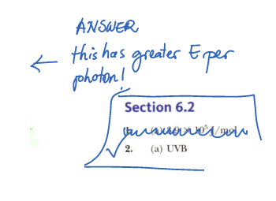
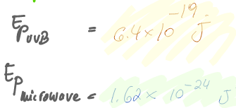
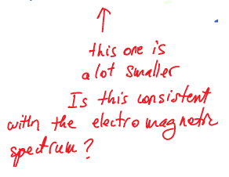
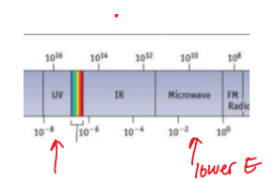

What was the Q again?
6.41

